Slide 1
ECEG-5193: Algorithm Analysis and Design
Algorithms of Graph Problems
Connected Components

Slide 2
Connected Components

Slide 5
Connected Components
Let G = (V, E) be an undirected graph.
Two nodes u, v ∈ V are called connected iff there is a path from u to v.
A connected component of G is a set C ⊆ V
with the following properties:
C is nonempty.
For any u, v ∈ C: u and v are connected.
For any u ∈ C, v ∈ V – C: u and v are not connected.

Slide 6
Properties of Connected Components
All of the following are true:
Any two connected components C₁ and C₂ are either equal or disjoint.
Every node in a graph belongs to exactly one connected component.
The connected components of a graph form a partition of the nodes of the graph.
Notes:
it's an interesting exercise to prove them

Slide 7
Finding Connected Components
Run DFS …

Slide 12
0

Slide 13
0
0

Slide 14
0
0
0

Slide 15
0
0
0
0

Slide 16
0
0
0
0
0

Slide 17
0
0
0
0
0

Slide 18
0
0
0
0
0

Slide 19
0
0
0
0
0

Slide 20
0
0
0
0
0

Slide 21
0
0
0
0
0

Slide 22
0
0
0
0
0

Slide 23
0
0
0
0
0

Slide 24
0
0
0
0
0

Slide 25
0
0
0
0
0

Slide 26
0
0
0
0
0

Slide 27
0
0
0
0
0

Slide 28
0
0
0
0
0

Slide 29
0
0
0
0
0

Slide 30
0
0
0
0
0

Slide 31
0
0
1
0
0
0

Slide 32
0 | 0 | 1
0 | 0 | 1
 | 0

Slide 33
0 | 0 | 1
0 | 0 | 1
 | 0 | 1

Slide 34
0
0
1
1
0
0
1
0
1

Slide 35
0
0
1
1
0
0
1
0
1

Slide 36
0
0
1
1
0
0
1
0
1

Slide 37
0
0
1
1
0
0
1
0
1

Slide 38
0
0
1
1
0
0
1
0
1

Slide 39
0
0
1
1
0
0
1
0
1

Slide 40
0
0
1
1
0
0
1
0
1

Slide 41
0
0
1
1
0
0
1
0
1

Slide 42
0
0
1
1
0
0
1
0
1

Slide 43
0
0
1
1
0
0
1
0
1

Slide 44
0
0
1
1
0
0
1
0
1

Slide 45
0
0
1
1
0
0
1
0
1

Slide 46
0
0
1
1
0
0
1
0
1

Slide 47
0
0
1
1
0
0
1
0
1

Slide 48
0
0
1
1
0
0
1
0
1

Slide 49
0 | 0 | 1 | 1
0 | 0 | 1 | 2
 | 0 | 1 | 2

Slide 50
procedure findCCs(graph G):
for each node v: color v gray
let cc be an array of size n
let index = 0
for each node in v:
if v is gray:
run DFS(v), setting cc[u] = index
whenever a node u is colored green index = index + 1
return cc

Slide 51
Analyzing the Runtime
We do Θ(n) work initially coloring each node gray.
Across all iterations of DFS, each node is visited exactly once and each edge is visited exactly once. This takes Θ(m + n) time.
Consequently, total work is Θ(m + n).
Could we also use BFS here? If so, what would the runtime be?

Slide 52
Strongly Connected Components

Slide 53
Strongly connected
Given a directed graph, can we reach any node v from any other node u?
Ideas?

Slide 54
Directed Connectivity
In a directed graph G, we say v is reachable from u iff there is a path from u to v.
In an undirected graph, if there is a path from u to v, there is also a path from v to u.
How would we generalize the idea of a connected component to a directed graph?
Notes:
In a directed graph, it is possible for there v to be reachable from u, but for u not to be reachable from v.

Slide 55
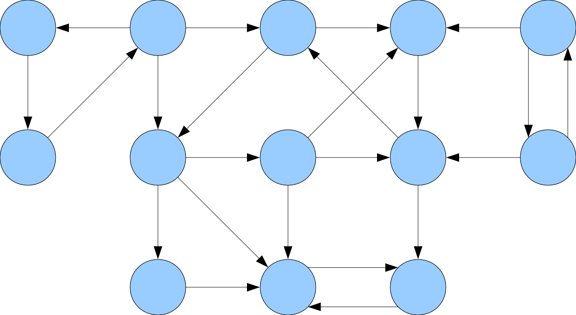

Slide 56
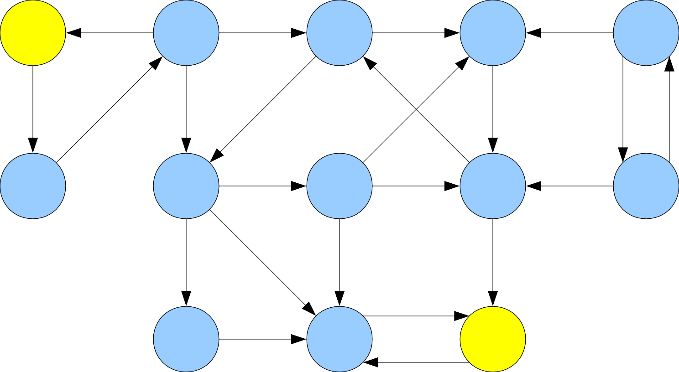
★
■

Slide 57
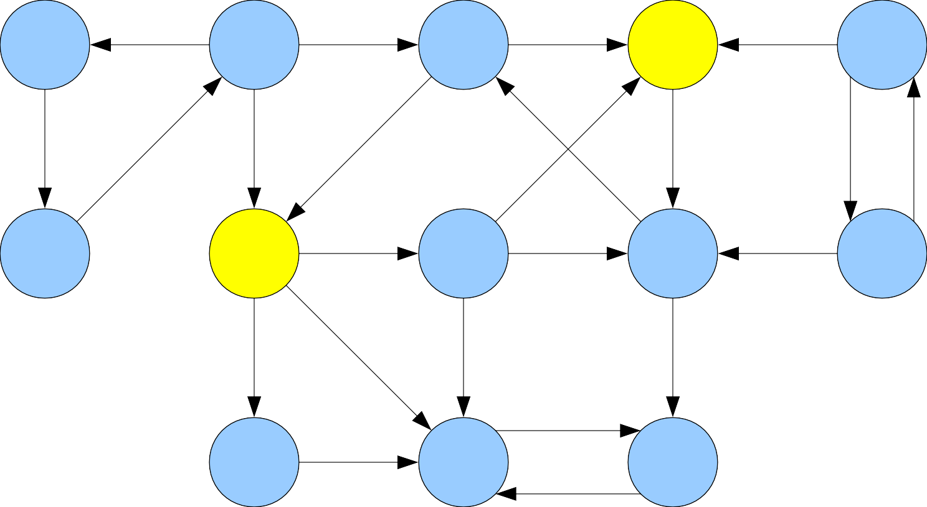
★
■

Slide 58
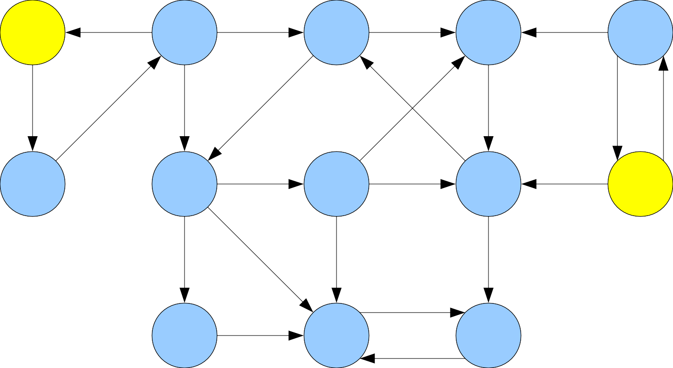
■
★

Slide 60
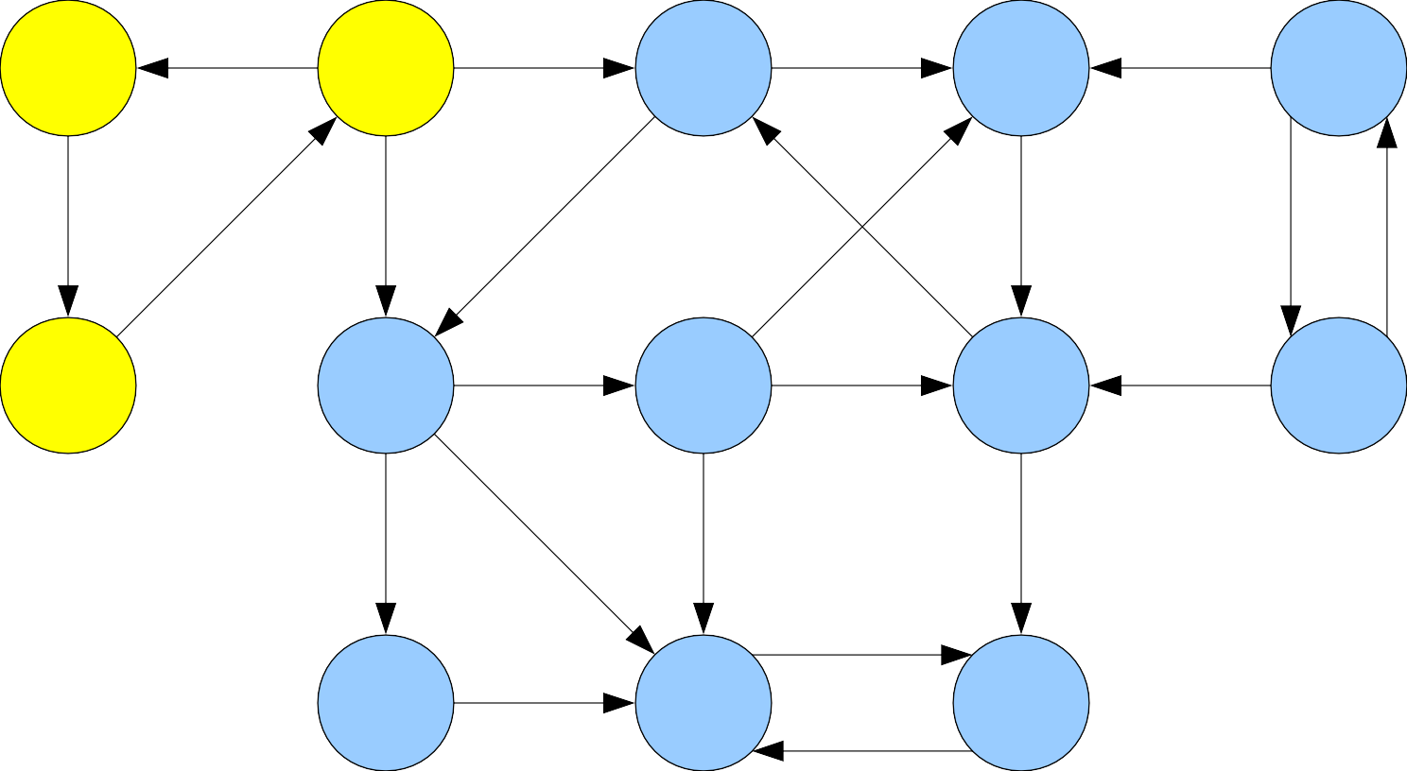

Slide 61
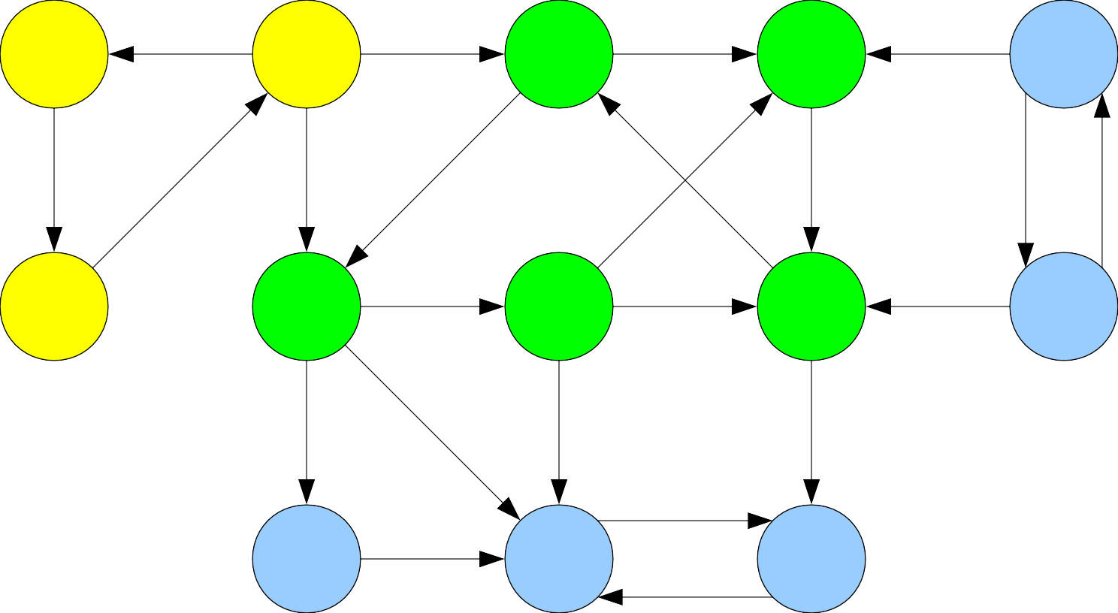

Slide 62
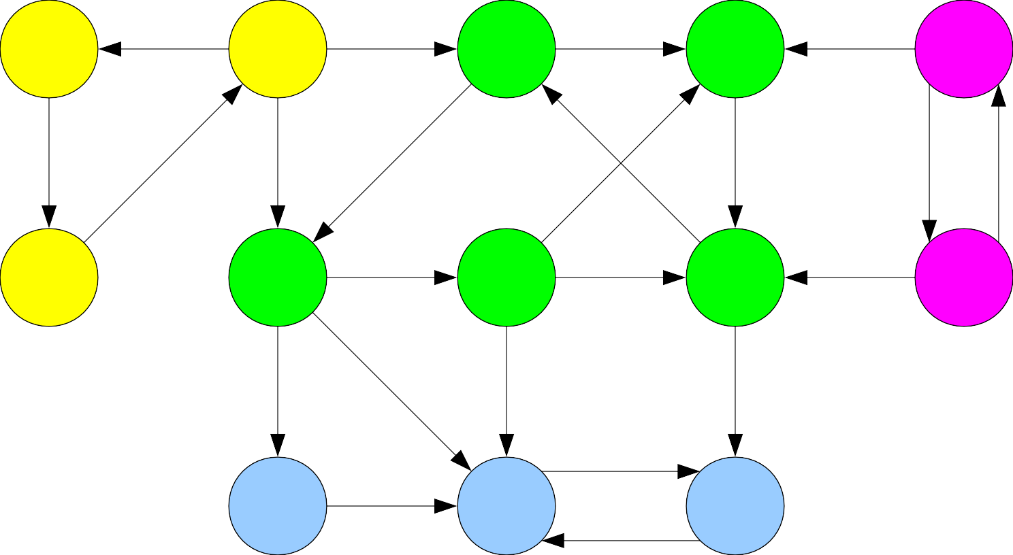

Slide 63


Slide 65
Strongly Connected Components
Let G = (V, E) be a directed graph.
Two nodes u, v ∈ V are called strongly connected iff v is reachable from u and u is reachable from v.
A strongly connected component (or SCC) of G is a set C ⊆ V such that
C is not empty.
For any u, v ∈ C: u and v are strongly connected.
For any u ∈ C and v ∈ V – C: u and v are not strongly connected.

Slide 72
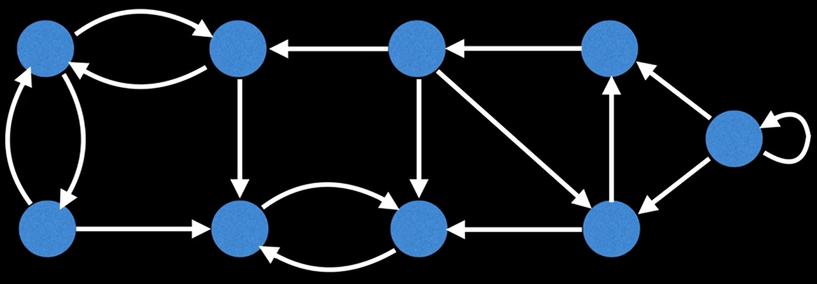
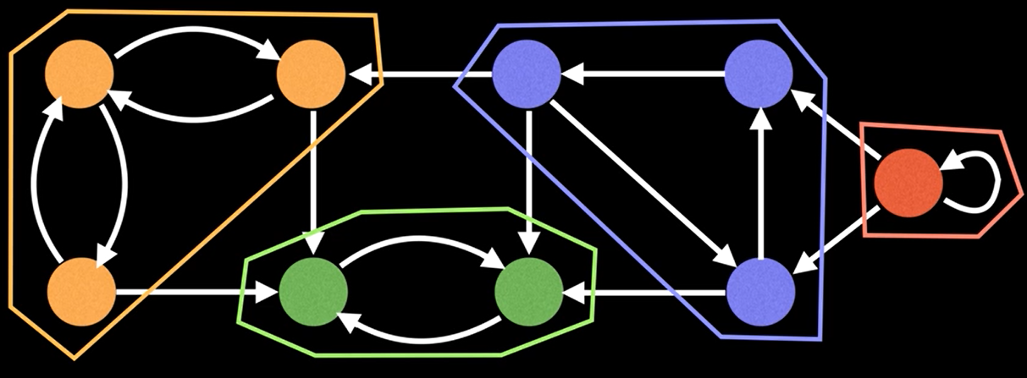

Slide 73
Properties of SCCs
The following properties of SCCs are true:
Two SCCs C₁ and C₂ are either equal or disjoint.
Every node belongs to exactly one SCC.
The SCCs of a graph form a partition of the nodes of the graph.

Slide 74
Finding SCCs
Every graph must have a collection of SCCs.
In the undirected case, it was easy to find all the connected components of a graph by using DFS or BFS.
Will this find all SCCs in a directed graph?
Question: How can we determine all of the strongly connected components of a directed graph G?

Slide 75
Kosaraju's Algorithm

Slide 76
procedure kosarajuSCC(graph G):
for each node v in G: color v gray. let L be an empty list. for each node v in G: if v is gray: run DFS starting at v, appending each node to list L when it is colored green. construct G^{R} from G. for each node v in GR: color v gray. let scc be a new array of length n let index = 0 for each node v in L, in reverse order: if v is gray: run DFS on v in GR, setting scc[u] = index for each node u colored green this way. index = index + 1 return scc

Slide 77
Transpose of a graph
Given a graph G, we can calculate the transpose of a graph G^{R} by reversing the direction of all the edges
G^{R}
G
A
A
B
B
D
D
E
E
C
C
Running time to calculate G^{R}?
O(|V| + |E|)

Slide 78
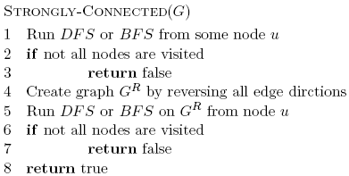
Runtime?
O(|V| + |E|)
O(|V|)
O(|V| + |E|)
O(|V| + |E|)
O(|V|)
O(|V| + |E|)

Slide 79
Strongly Connected Components
Let G = (V, E) be a directed graph.
Two nodes u, v ∈ V are called strongly connected iff v is reachable from u and u is reachable from v.
A strongly connected component (or
SCC) of G is a set C ⊆ V such that
●
●
●
C is not empty.
For any u, v ∈ C: u and v are strongly connected.
For any u ∈ C and v ∈ V – C: u and v are not strongly connected.
●
●
●

Slide 82
Condensation Graphs
The condensation of a directed graph G is the directed graph G^{SCC} whose nodes are the SCCs of G and whose edges are defined as follows:
(C₁, C₂) is an edge in G^{SCC} iff
∃u ∈ C₁, v ∈ C₂. (u, v) is an edge in G.
In other words, if there is an edge in G from any node in C₁ to any node in C₂, there is an edge in G^{SCC} from C₁ to C₂.
Theorem: G^{SCC} is a DAG for any graph G.

Slide 83
How do we find all the SCCs of a graph?

Slide 84
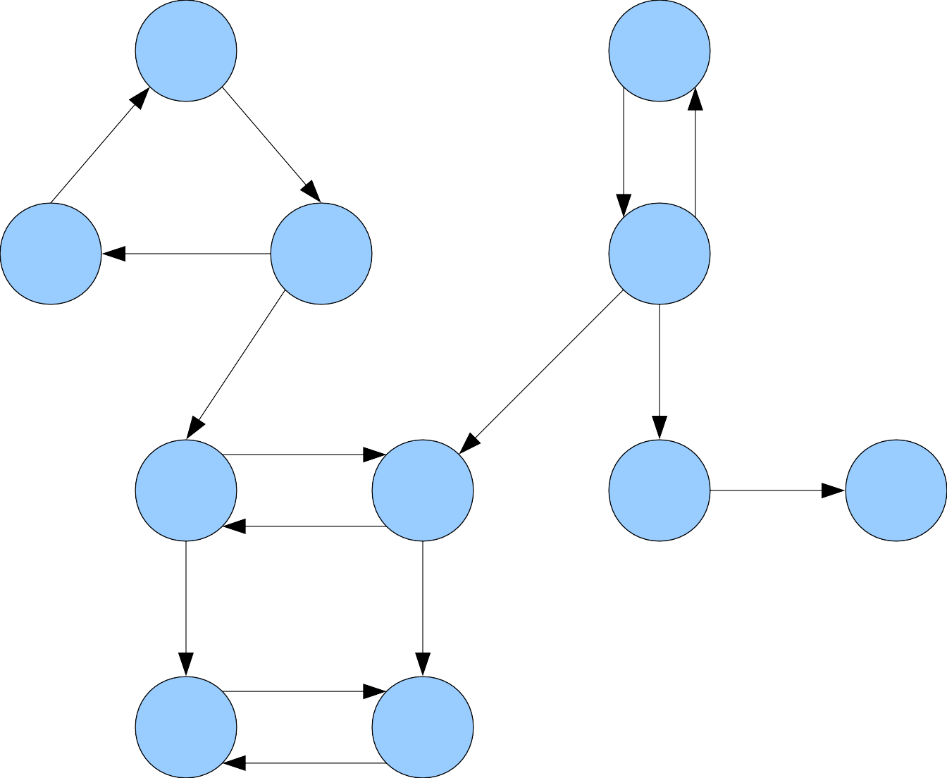
A |  |  | B
C | D |  | E
F |  | G | H I
J |  | K

Slide 85
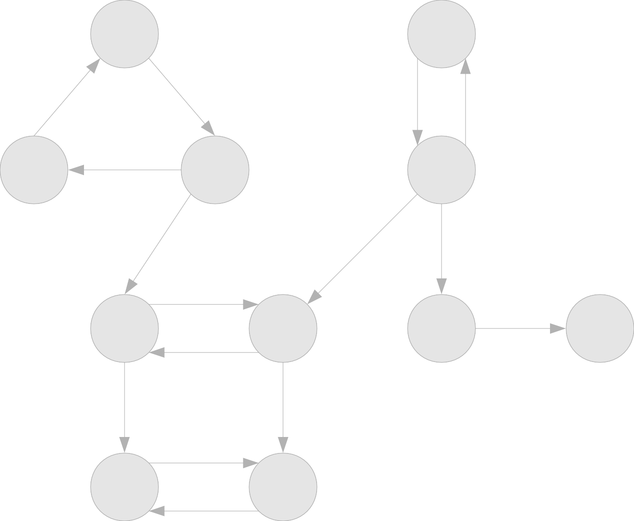
A |  |  | B
C | D |  | E
F |  | G | H I
J |  | K

Slide 86
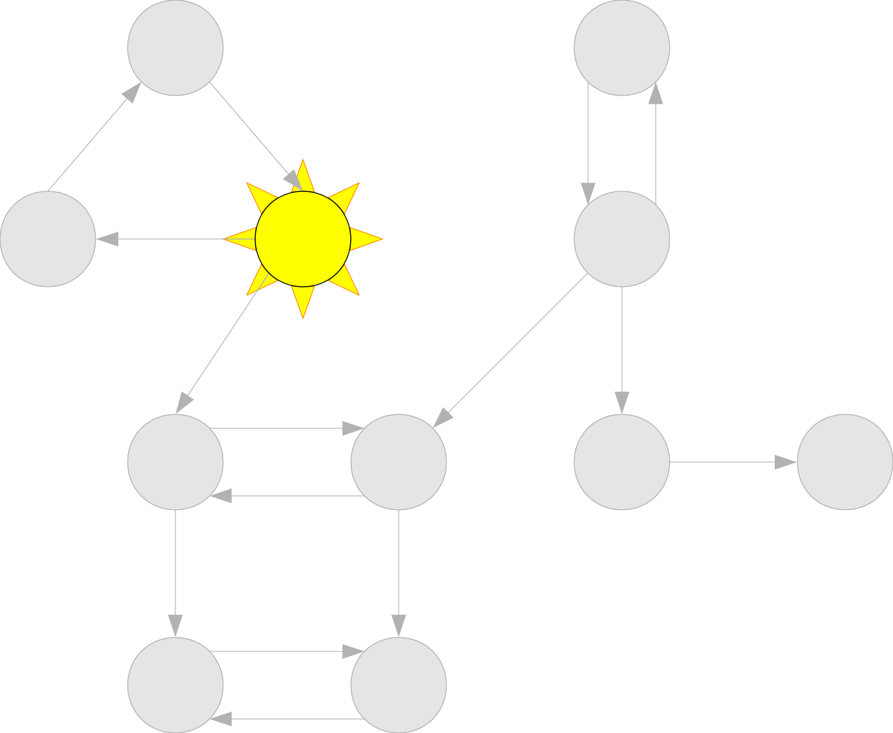
A |  |  | B
C | D |  | E
F |  | G | H I
J |  | K

Slide 87
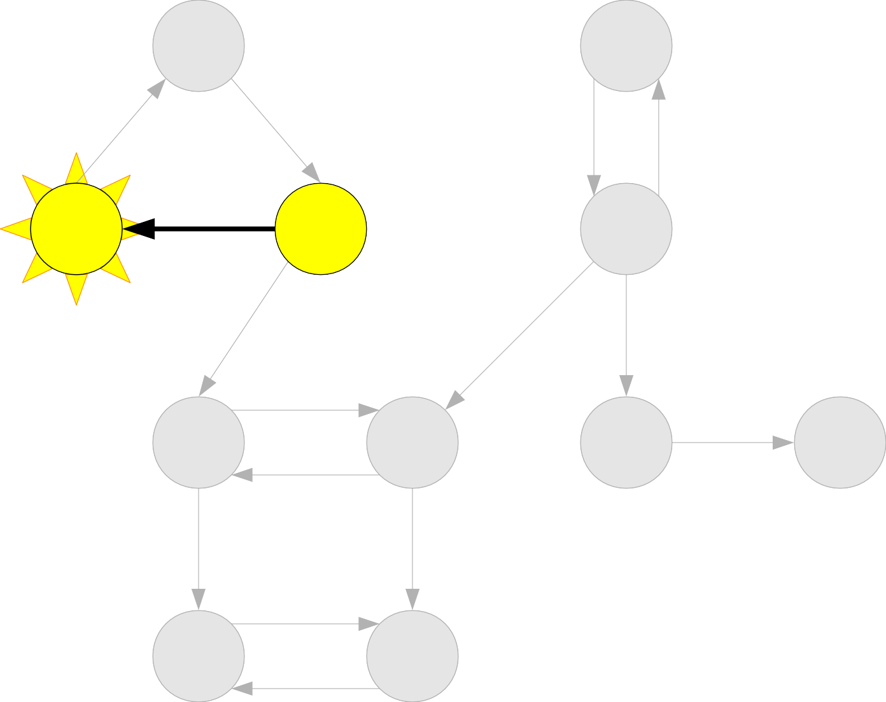
A |  |  | B
C | D |  | E
F |  | G | H I
J |  | K

Slide 88
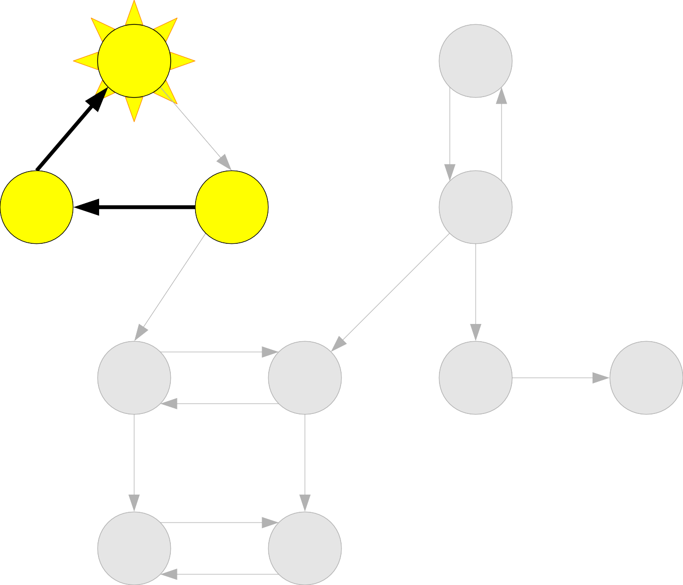
A |  |  | B
C | D |  | E
F |  | G | H I
J |  | K

Slide 89
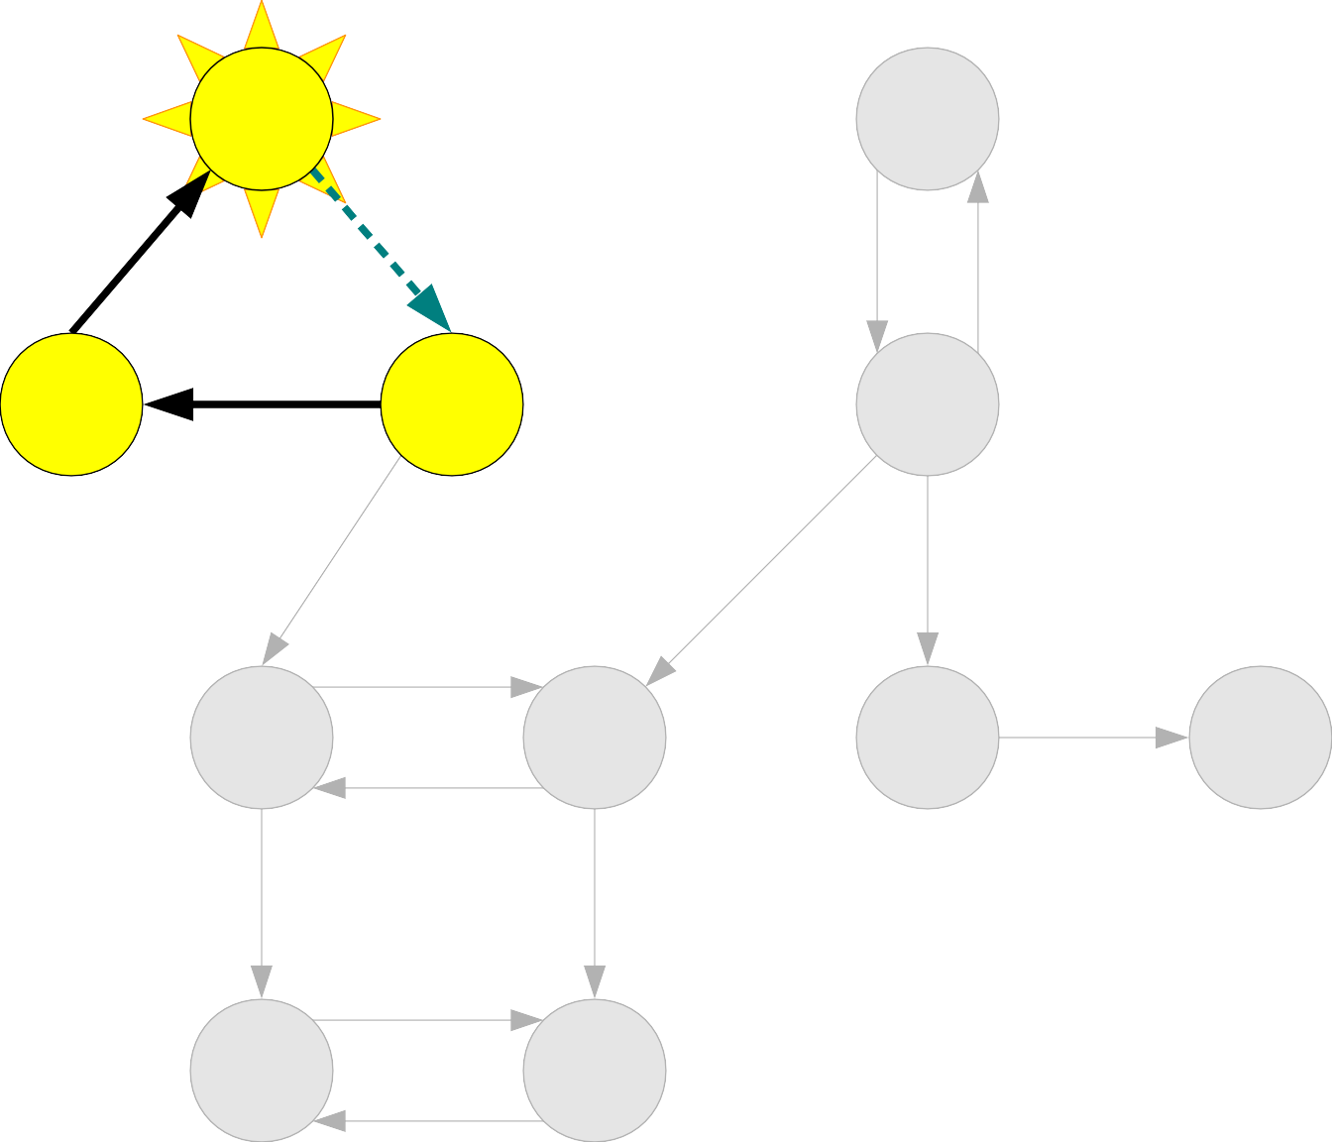
A |  |  | B
C | D |  | E
F |  | G | H I
J |  | K

Slide 90
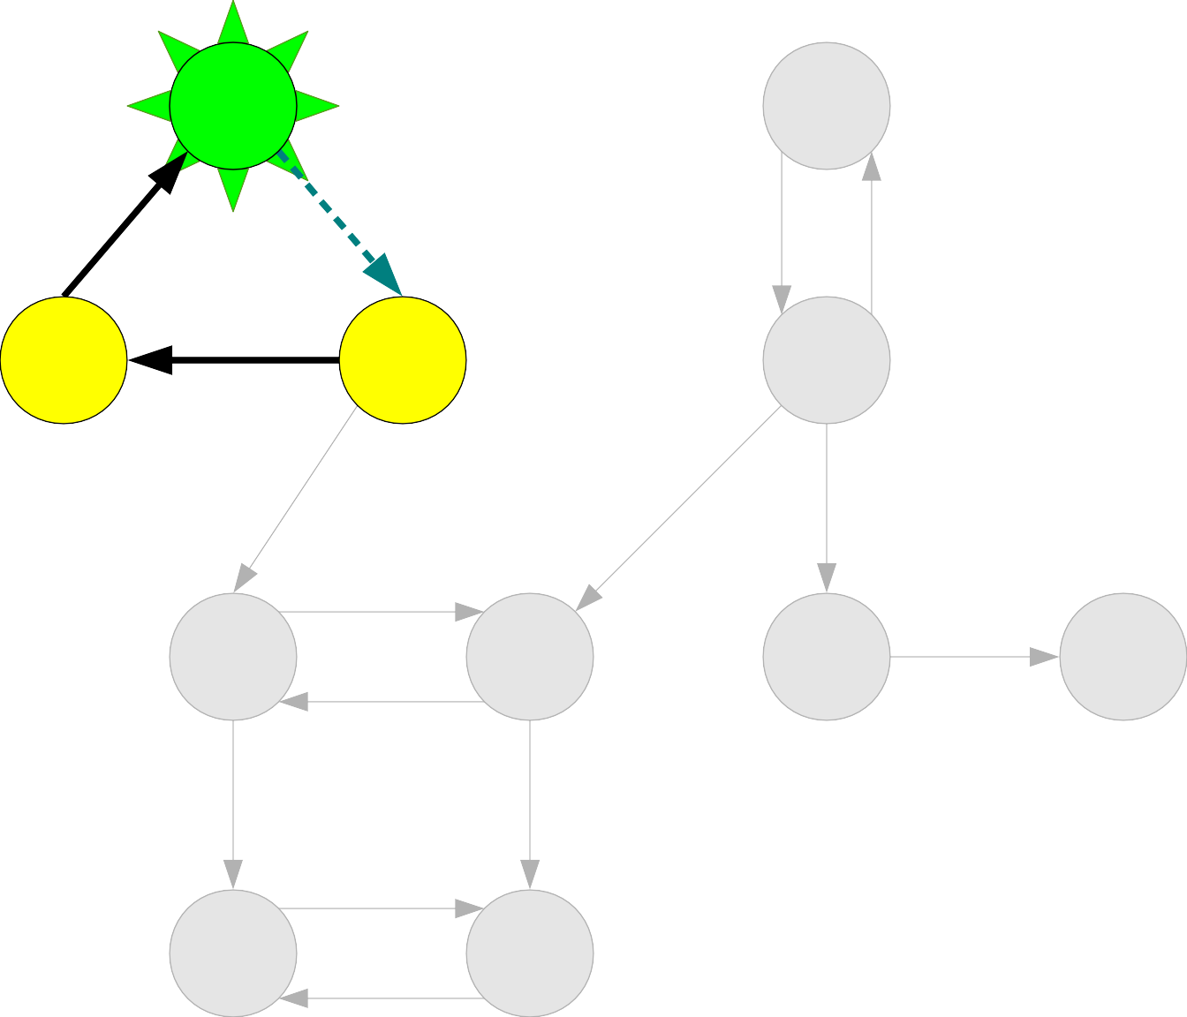
A |  |  | B
C | D |  | E
F |  | G | H I
J |  | K

Slide 91
A |  |  | B
C | D |  | E
F |  | G | H I
J |  | K
A

Slide 92
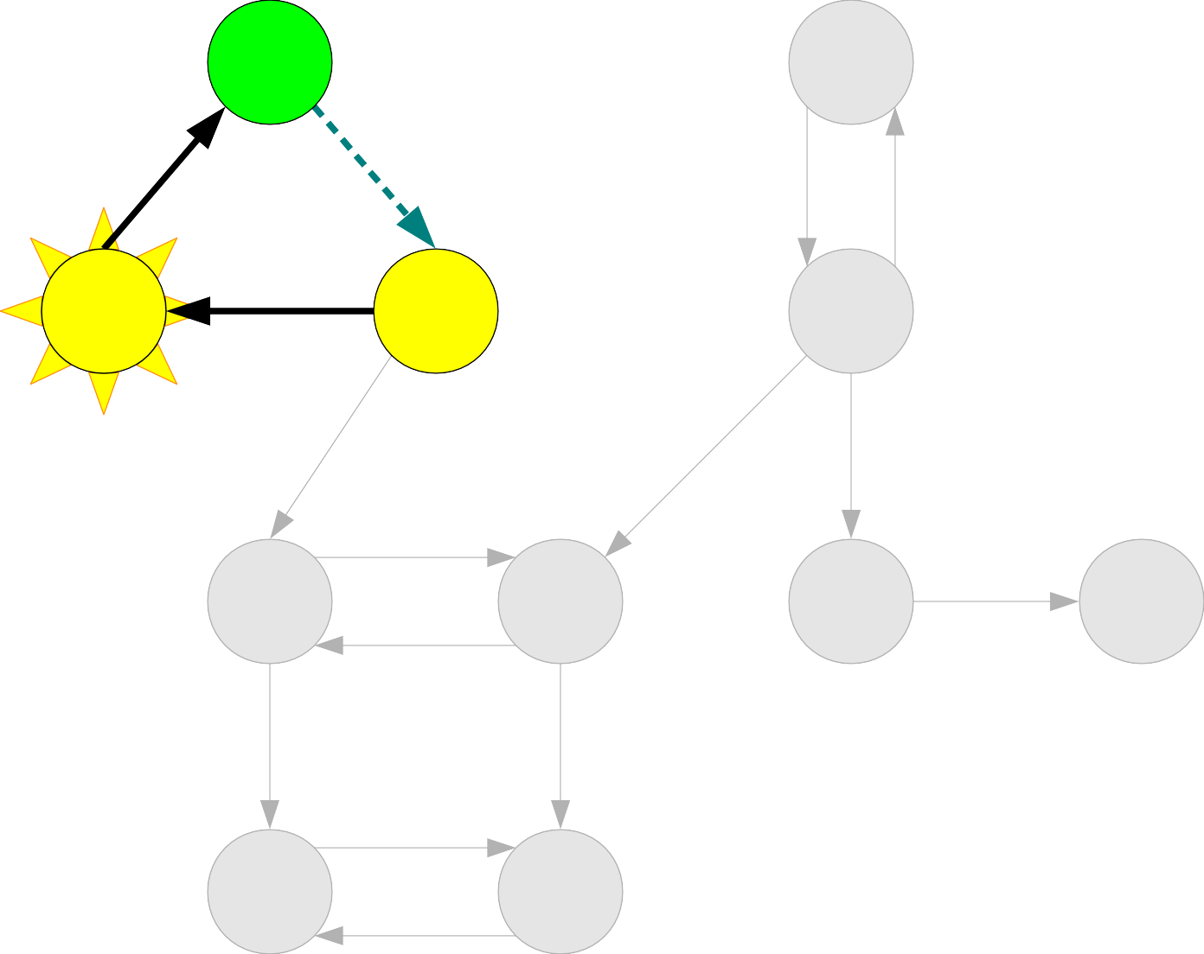
A |  |  | B
C | D |  | E
F |  | G | H I
J |  | K
A

Slide 93
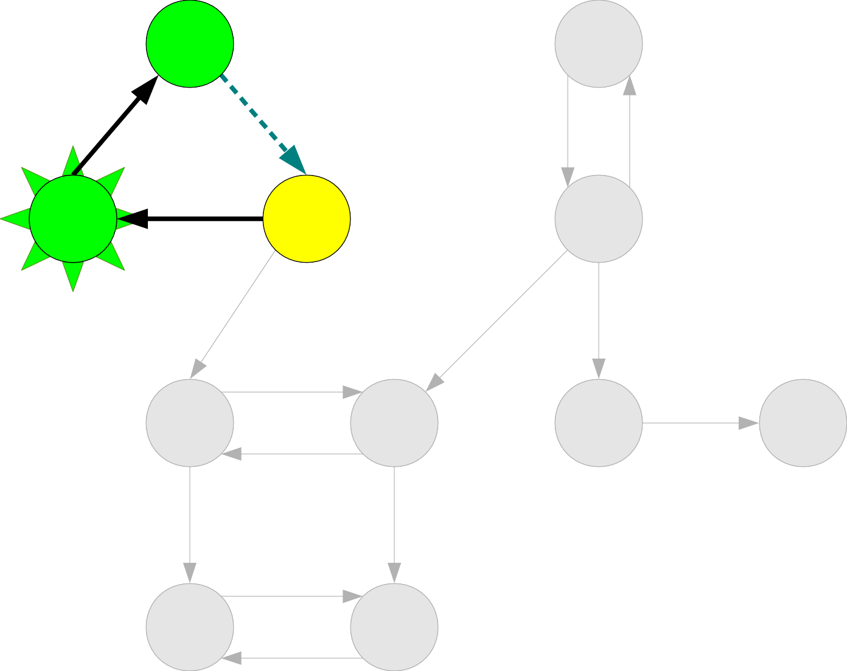
A |  |  | B
C | D |  | E
F |  | G | H I
J |  | K
A

Slide 94
A |  |  | B
C | D |  | E
F |  | G | H I
J |  | K
A
C

Slide 95
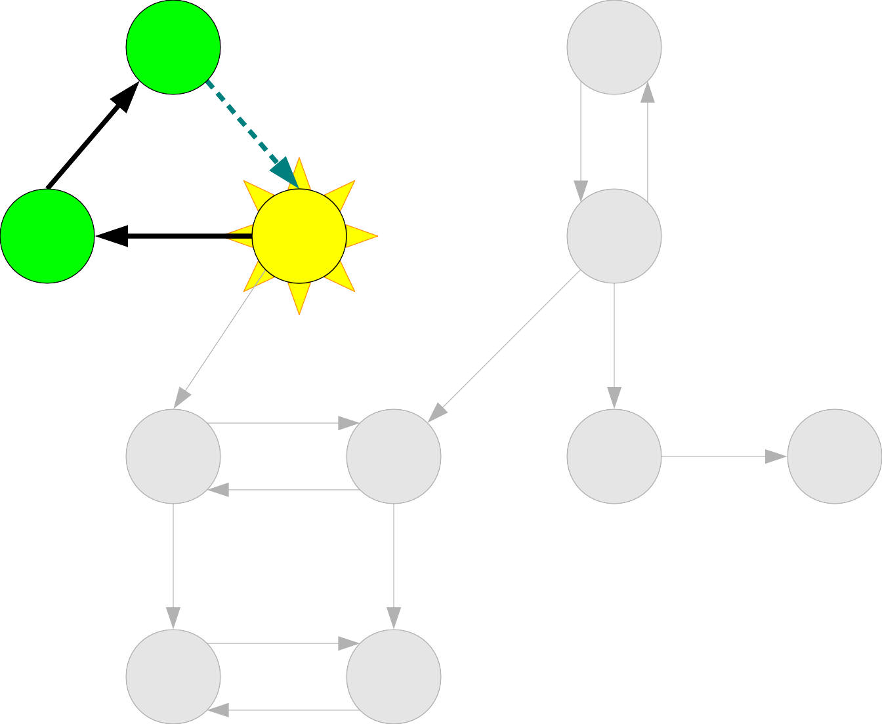
A |  |  | B
C | D |  | E
F |  | G | H I
J |  | K
A
C

Slide 96
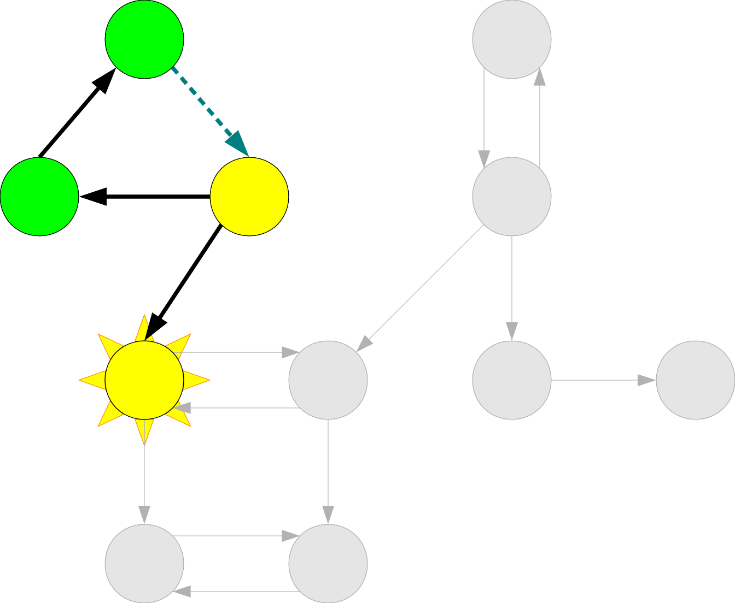
A |  |  | B
C | D |  | E
F |  | G | H I
J |  | K
A
C

Slide 97
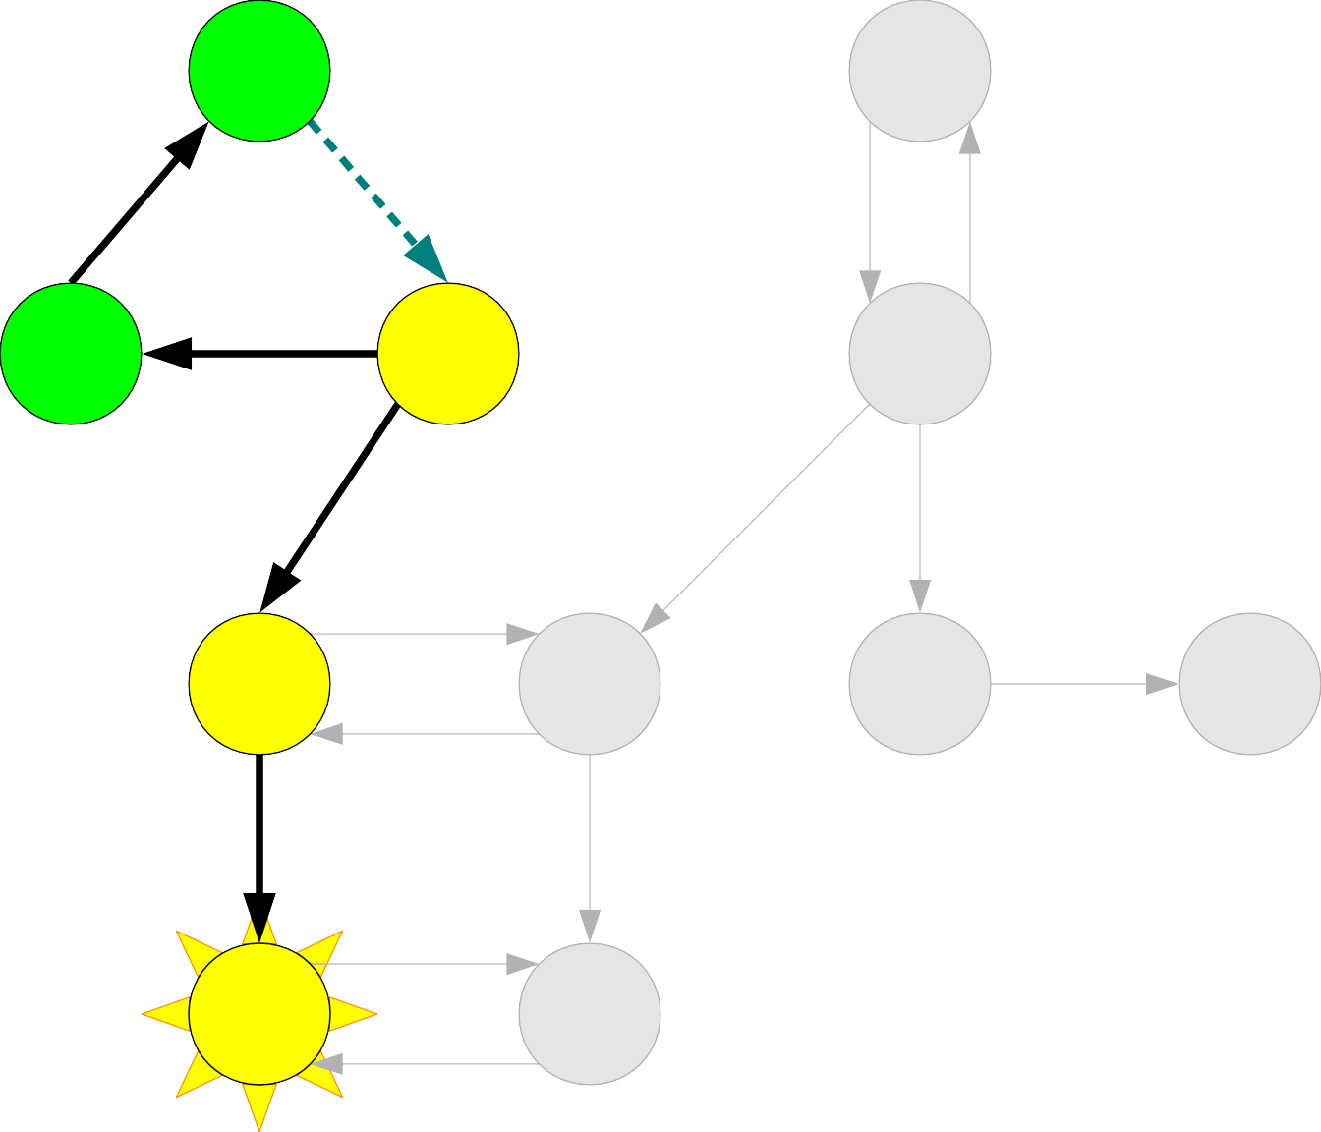
A |  |  | B
C | D |  | E
F |  | G | H I
J |  | K
A
C

Slide 98
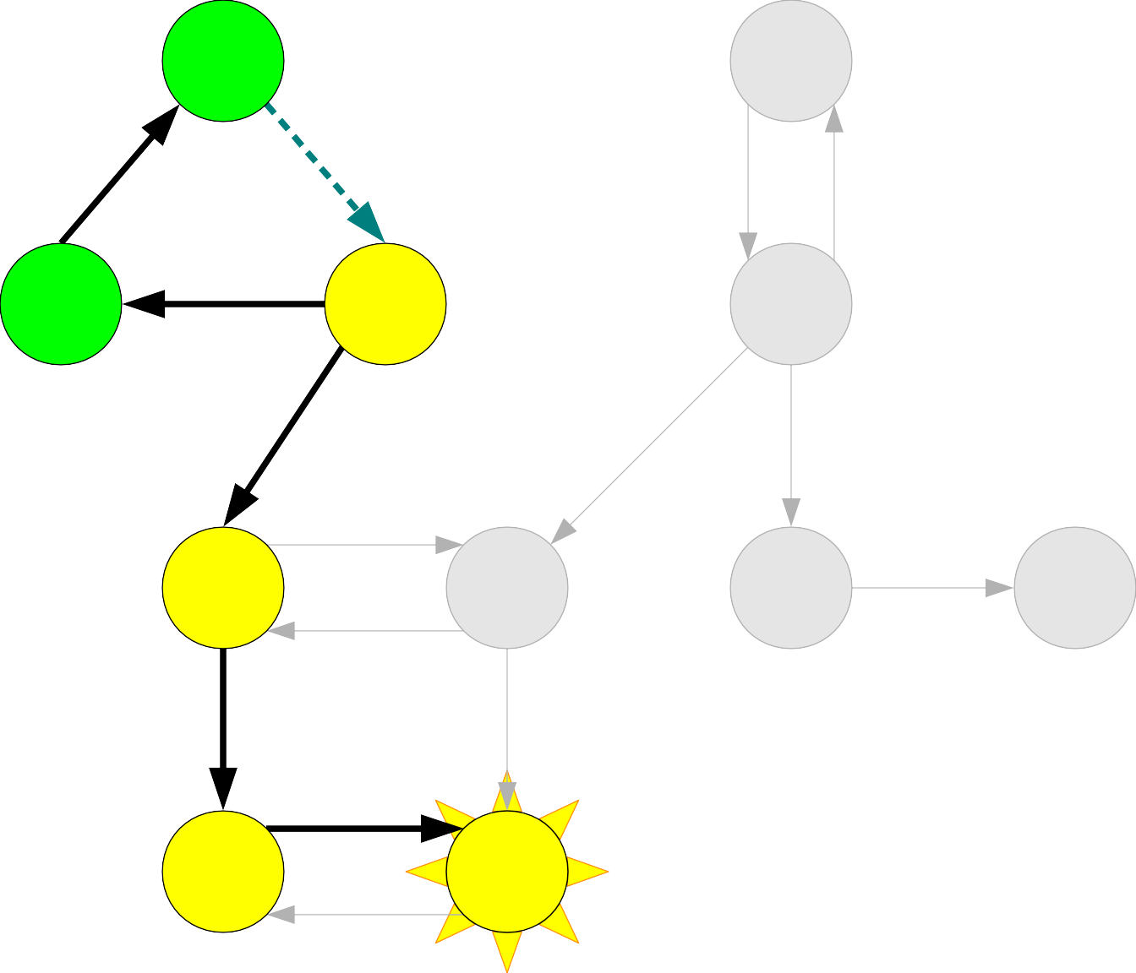
A |  |  | B
C | D |  | E
F |  | G | H I
J |  | K
A
C

Slide 99
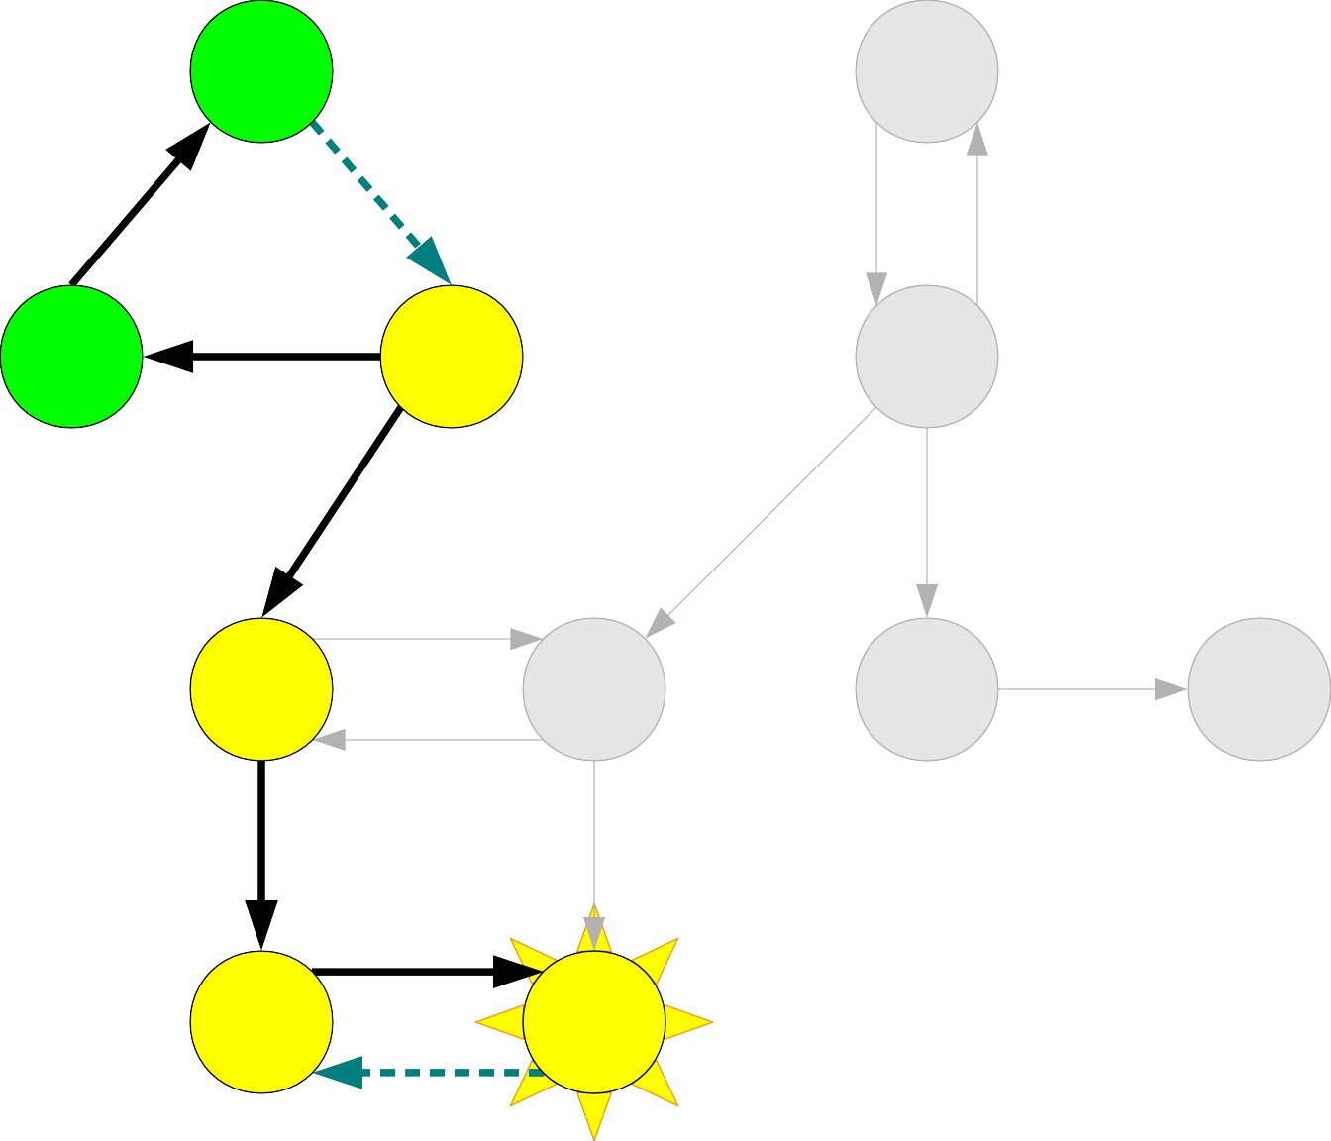
A |  |  | B
C | D |  | E
F |  | G | H I
J |  | K
A
C

Slide 100
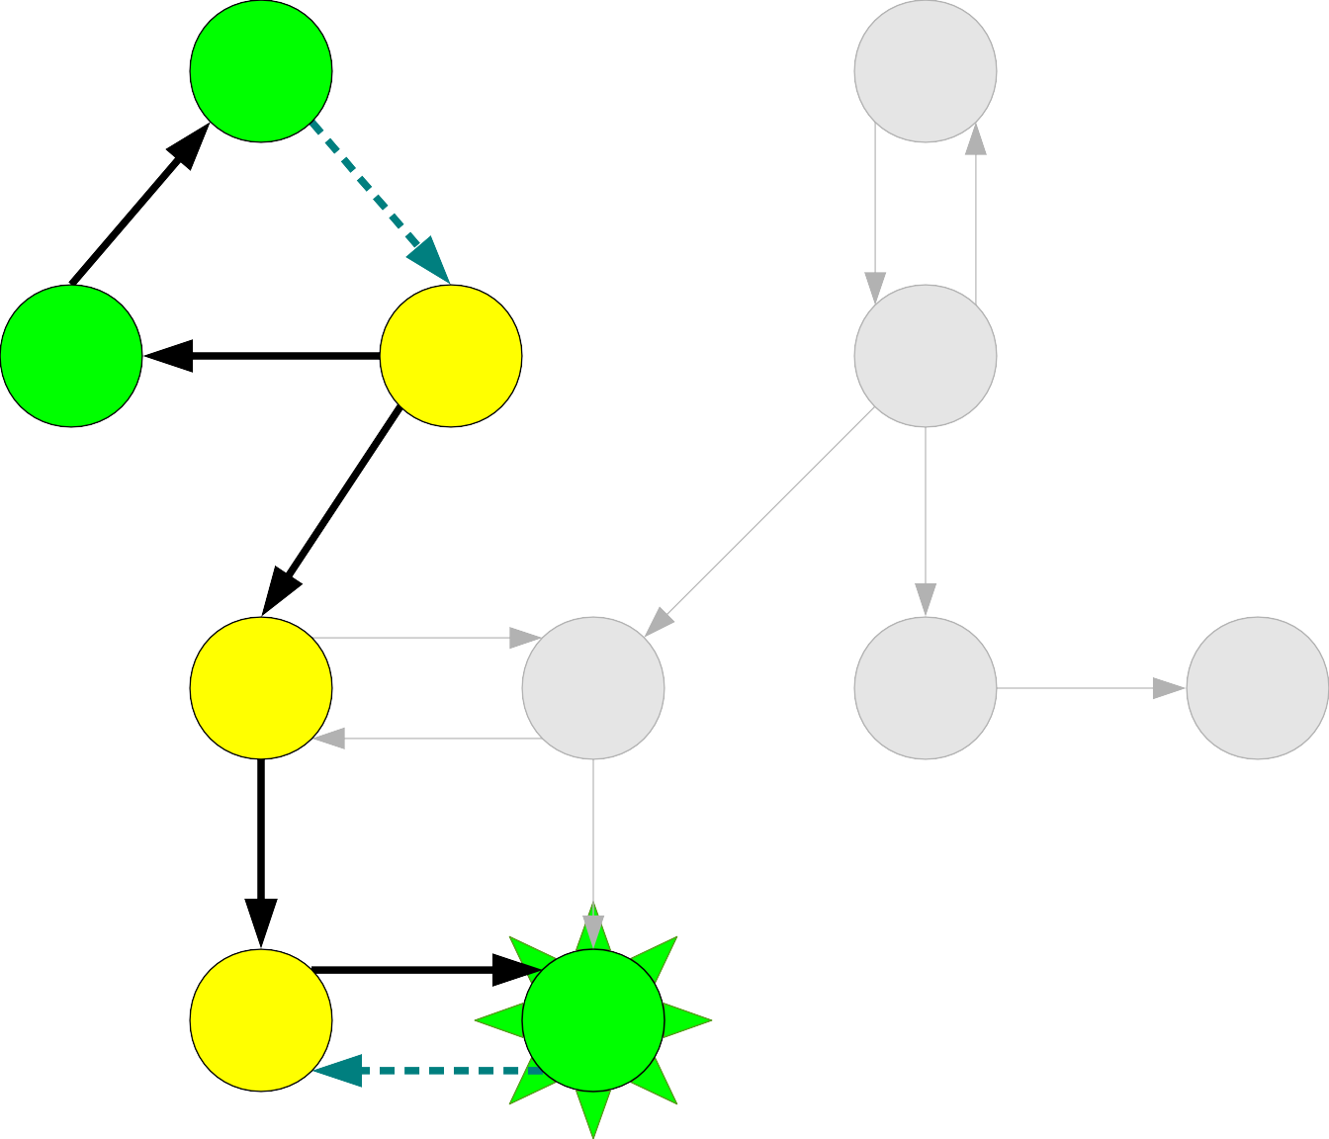
A |  |  | B
C | D |  | E
F |  | G | H I
J |  | K
A
C

Slide 101
A |  |  | B
C | D |  | E
F |  | G | H I
J |  | K
A
C
K

Slide 102
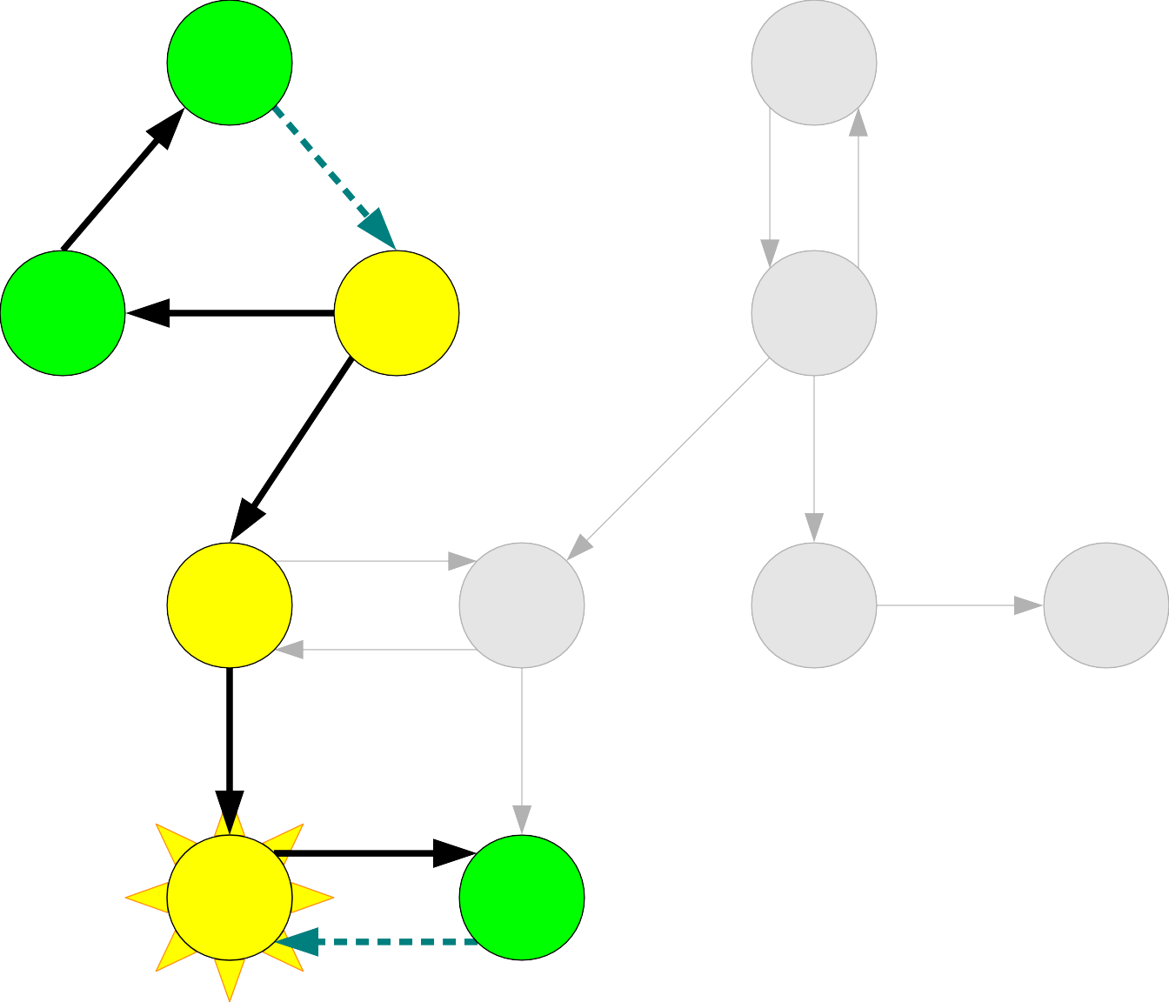
A |  |  | B
C | D |  | E
F |  | G | H I
J |  | K
A
C
K

Slide 103
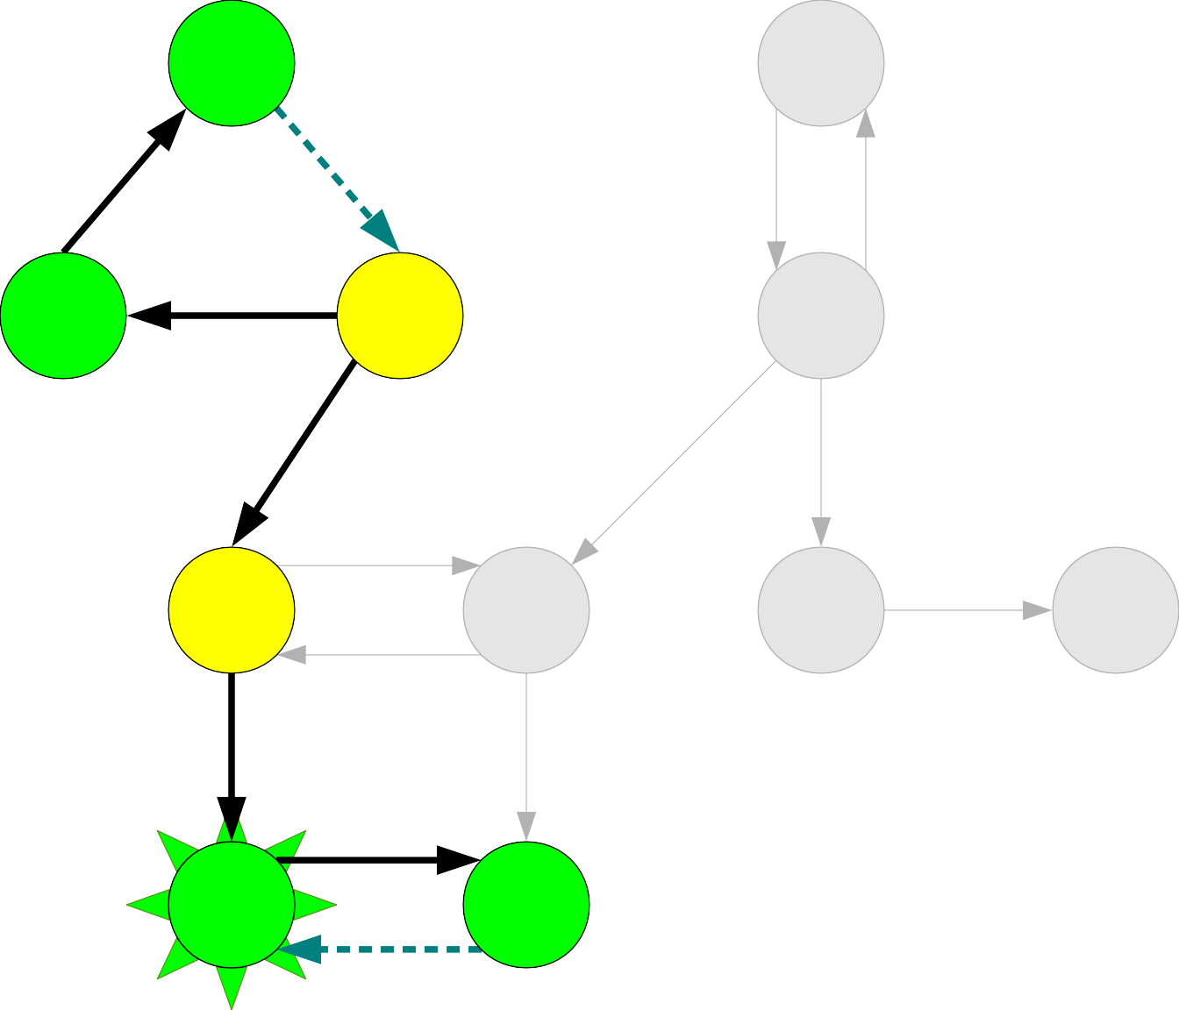
A |  |  | B
C | D |  | E
F |  | G | H I
J |  | K
A
C
K

Slide 104
A |  |  | B
C | D |  | E
F |  | G | H I
J |  | K
A
C
K
J

Slide 105
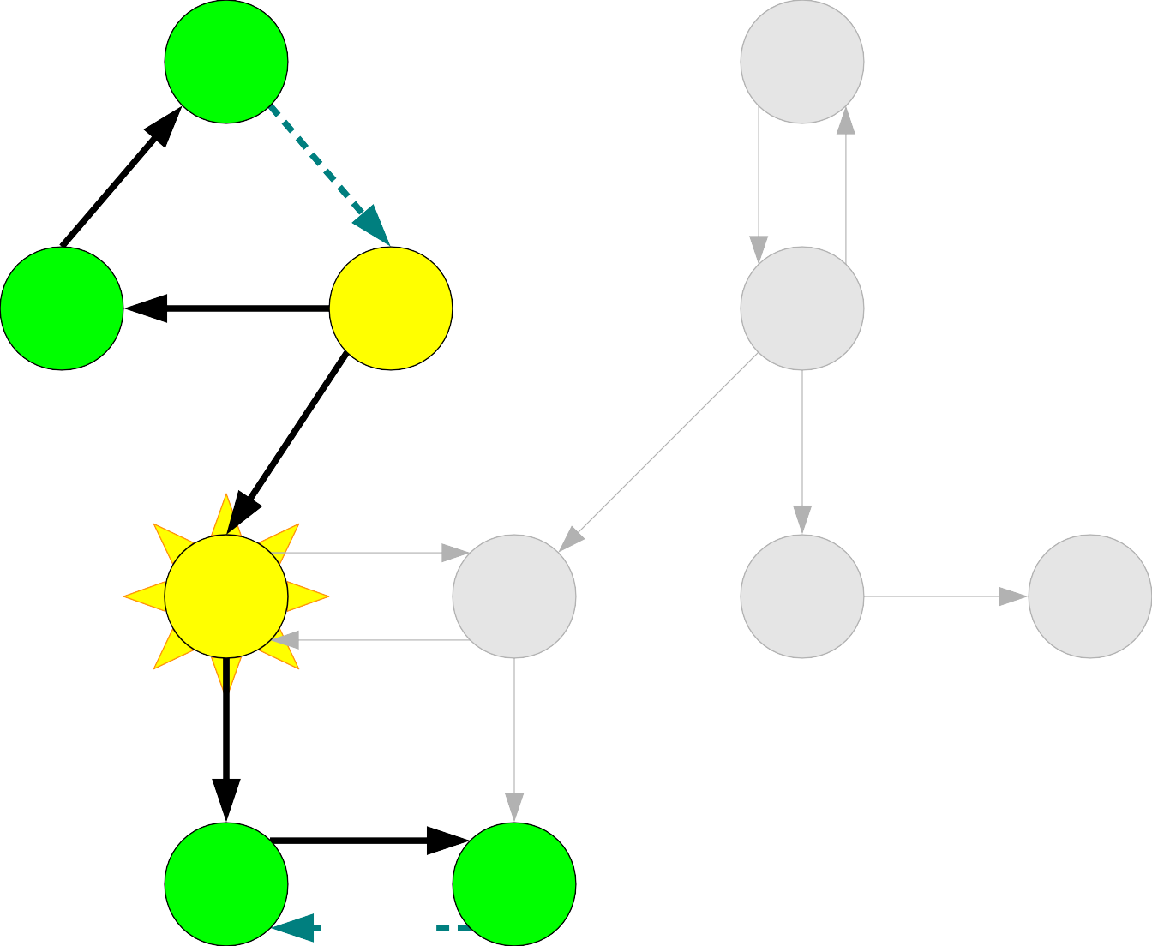
A |  |  | B
C | D |  | E
F |  | G | H I
J |  | K
A
C
K
J

Slide 106
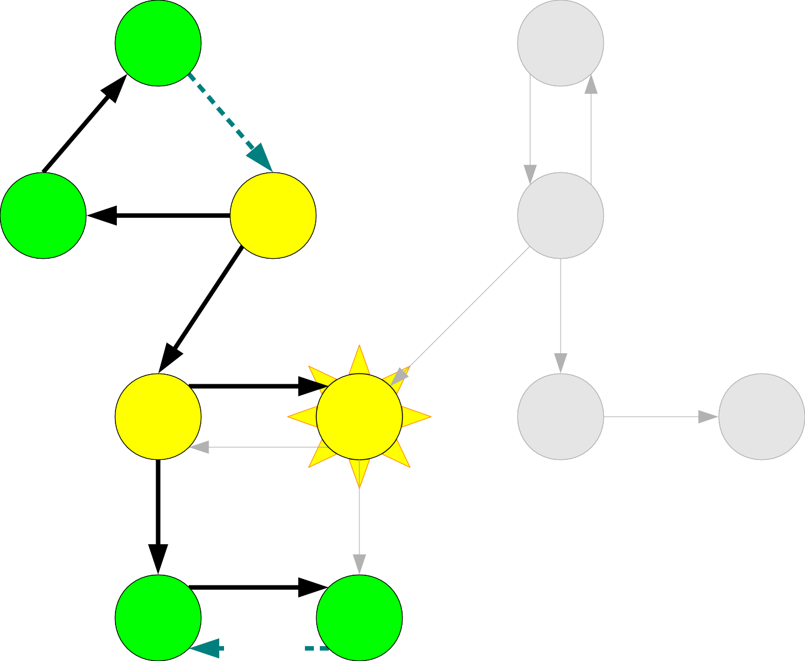
A |  |  | B
C | D |  | E
F |  | G | H I
J |  | K
A
C
K
J

Slide 107
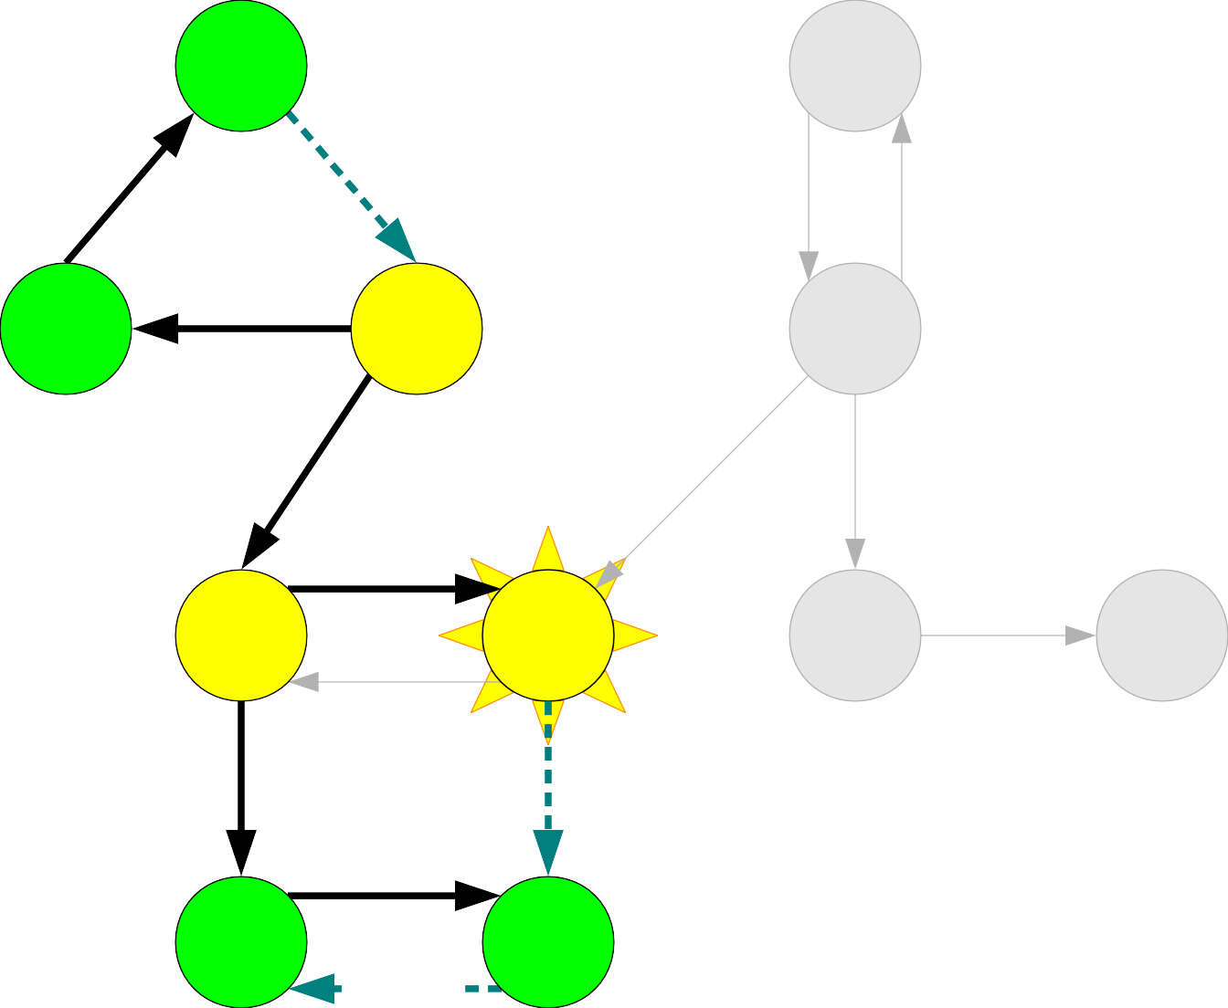
A |  |  | B
C | D |  | E
F |  | G | H I
J |  | K
A
C
K
J

Slide 108

A |  |  | B
C | D |  | E
F |  | G | H I
J |  | K
A
C
K
J

Slide 109
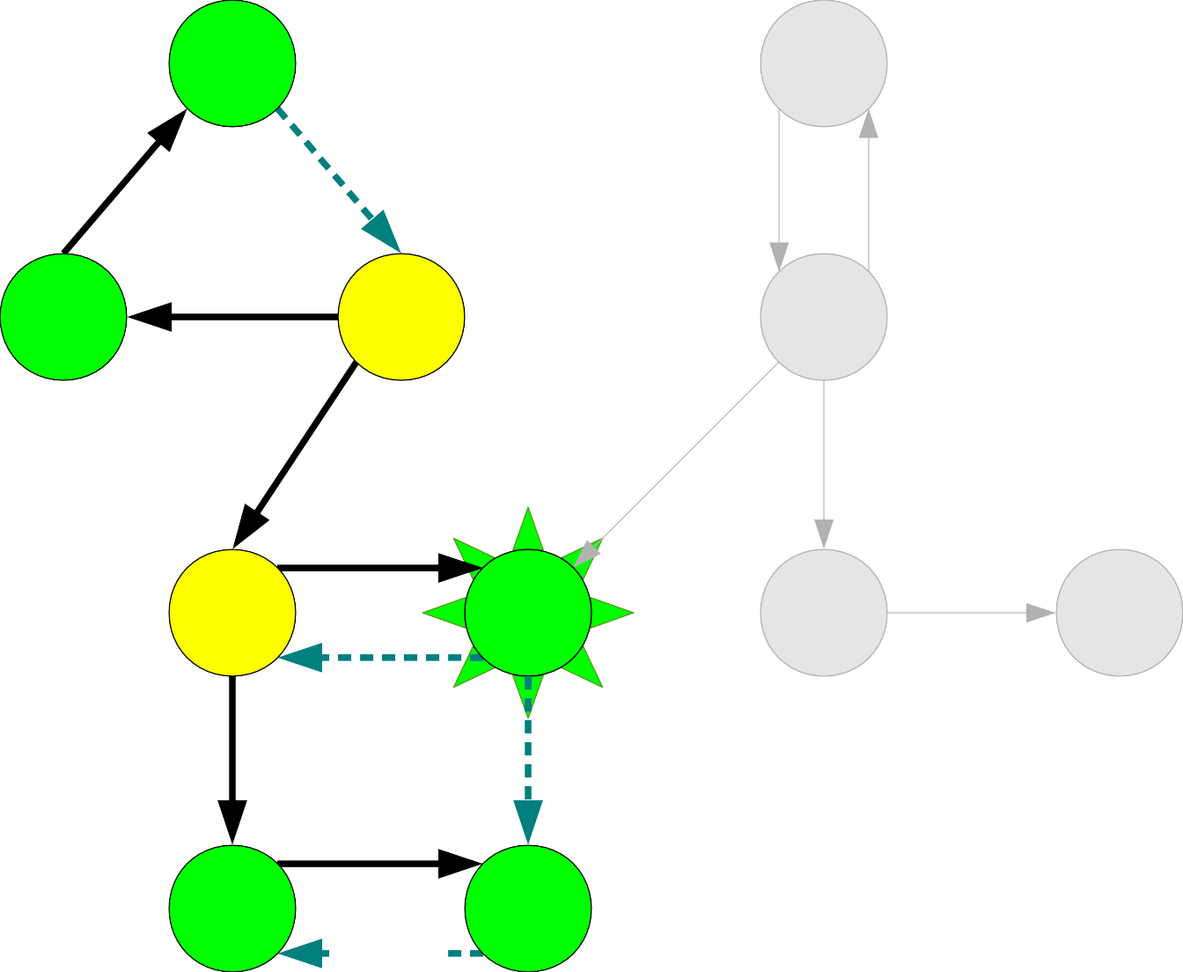
A |  |  | B
C | D |  | E
F |  | G | H I
J |  | K
A
C
K
J

Slide 110
A |  |  | B
C | D |  | E
F |  | G | H I
J |  | K
A
C
K
J
G

Slide 111
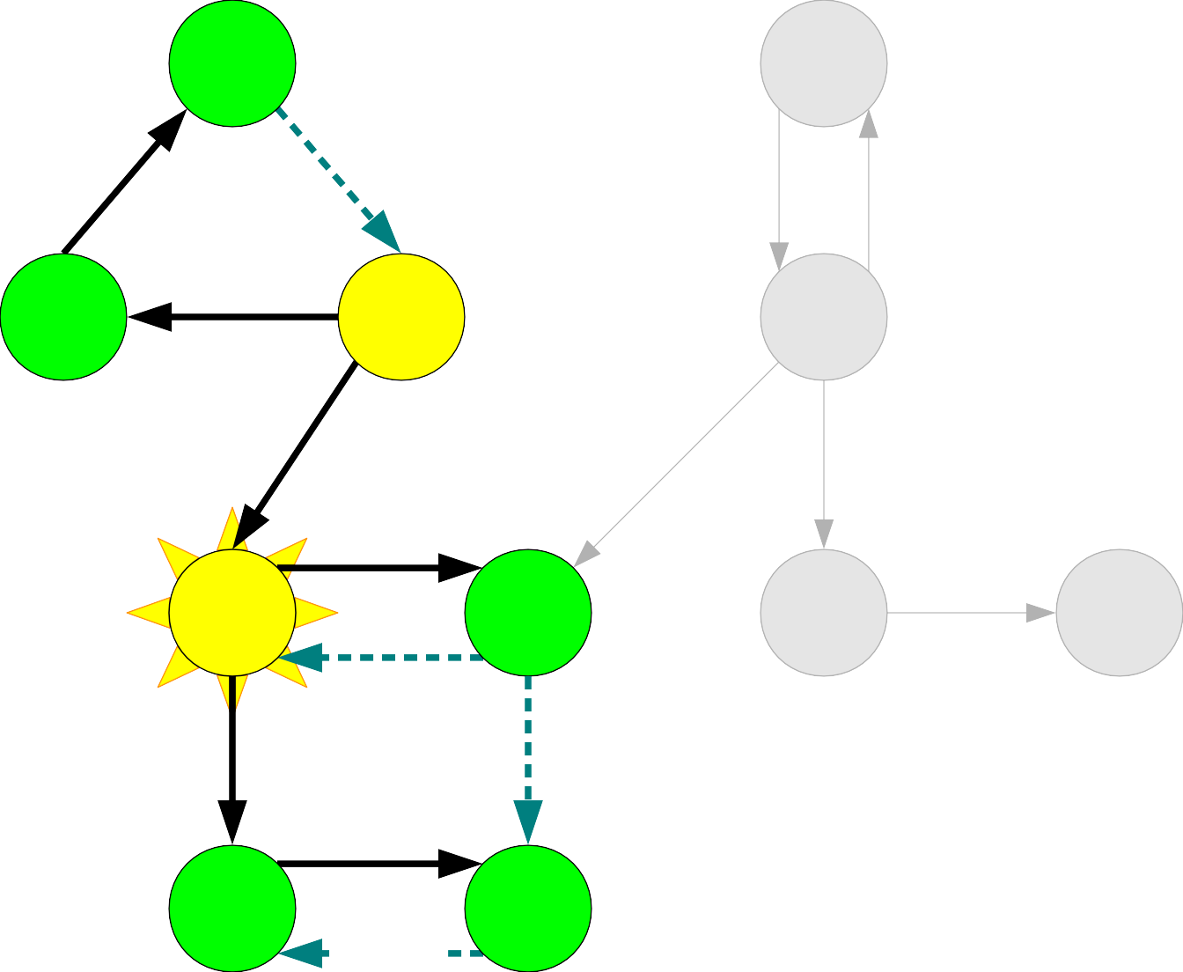
A |  |  | B
C | D |  | E
F |  | G | H I
J |  | K
A
C
K
J
G

Slide 112
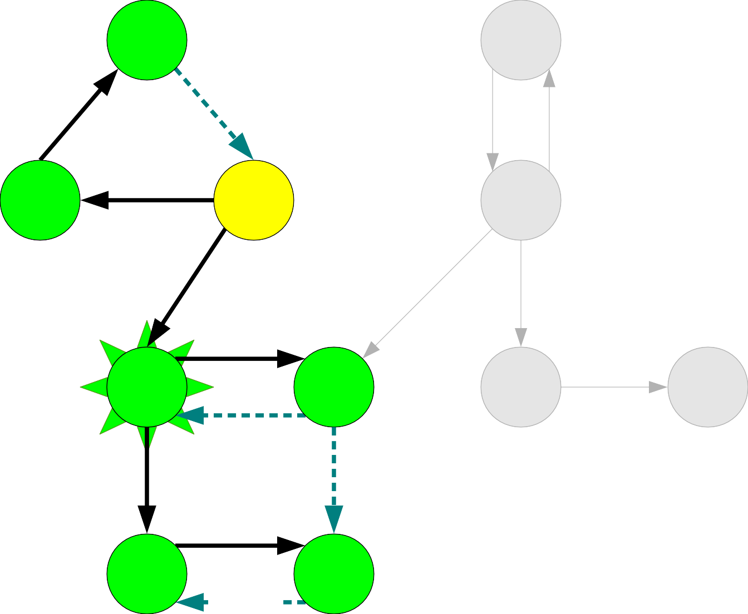
A |  |  | B
C | D |  | E
F |  | G | H I
J |  | K
A
C
K
J
G

Slide 113
A |  |  | B
C | D |  | E
F |  | G | H I
J |  | K
A
C
K
J
G
F

Slide 114
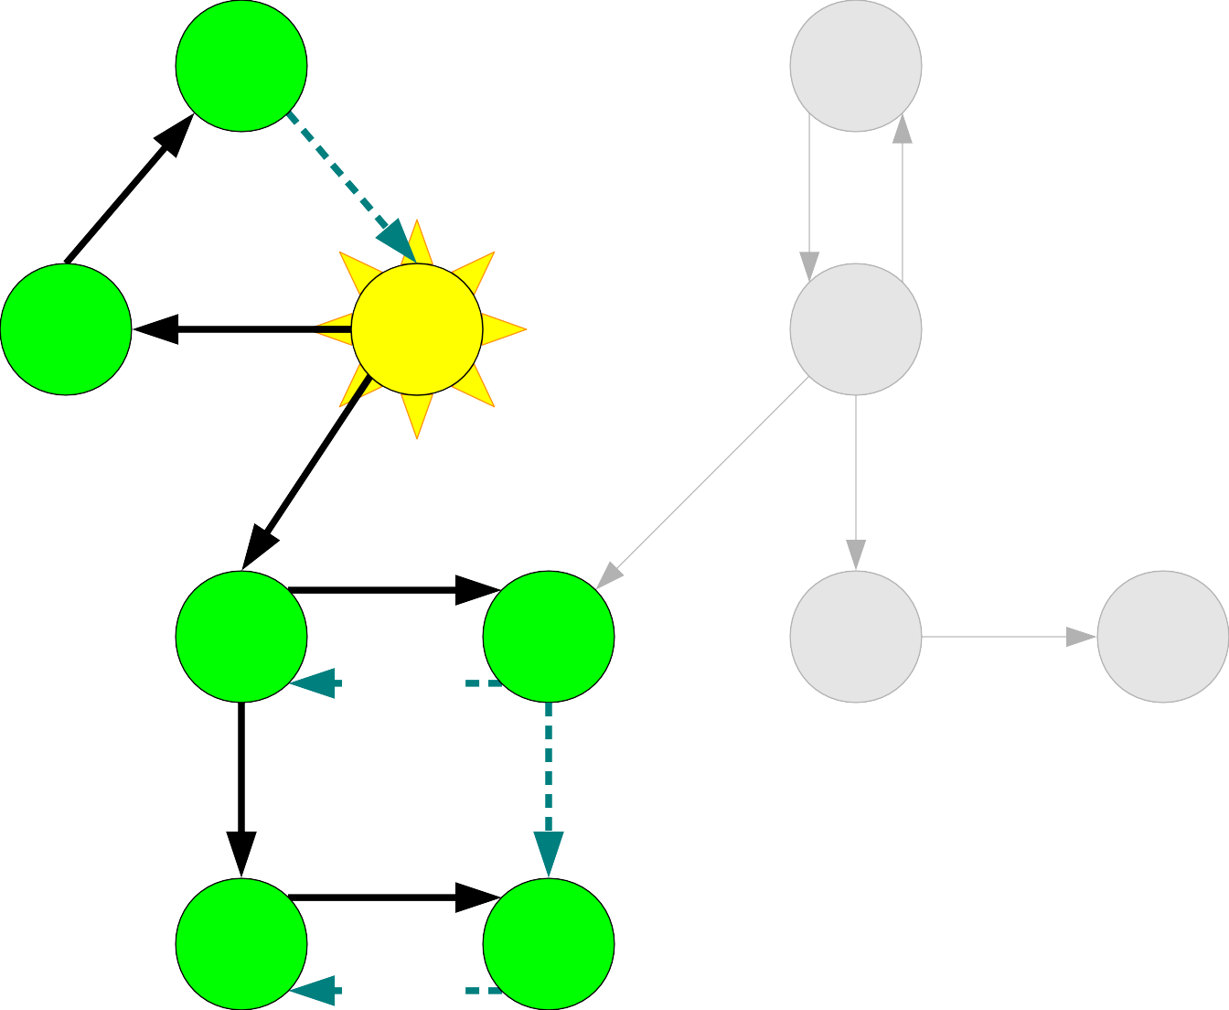
A |  |  | B
C | D |  | E
F |  | G | H I
J |  | K
A
C
K
J
G
F

Slide 115
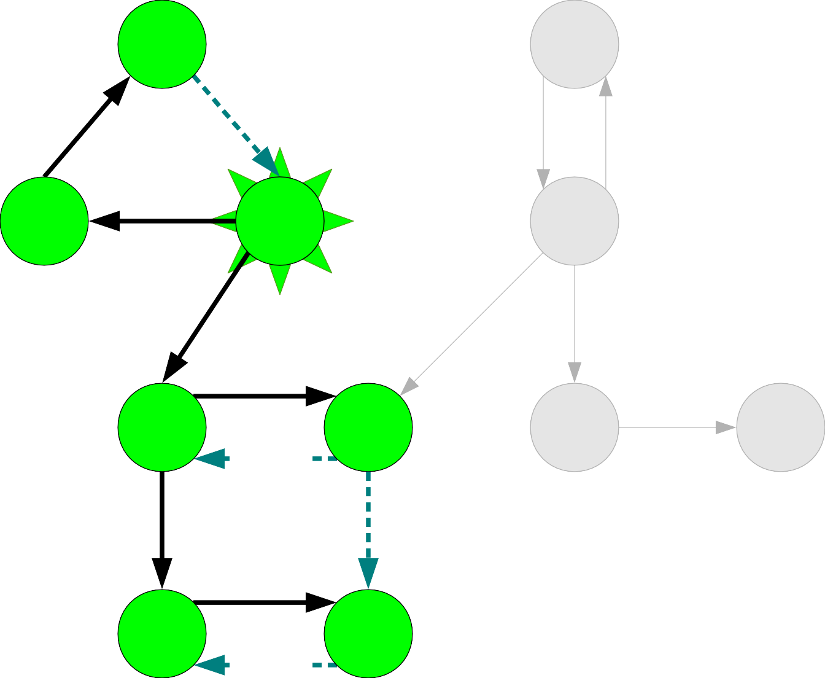
A |  |  | B
C | D |  | E
F |  | G | H I
J |  | K
A
C
K
J
G
F

Slide 116
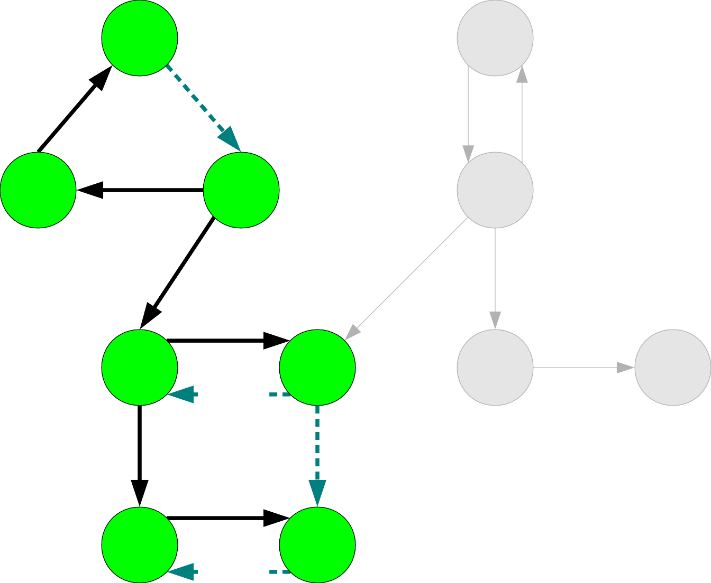
A |  |  | B
C | D |  | E
F |  | G | H I
J |  | K
A
C
K
J
G
F
D

Slide 117
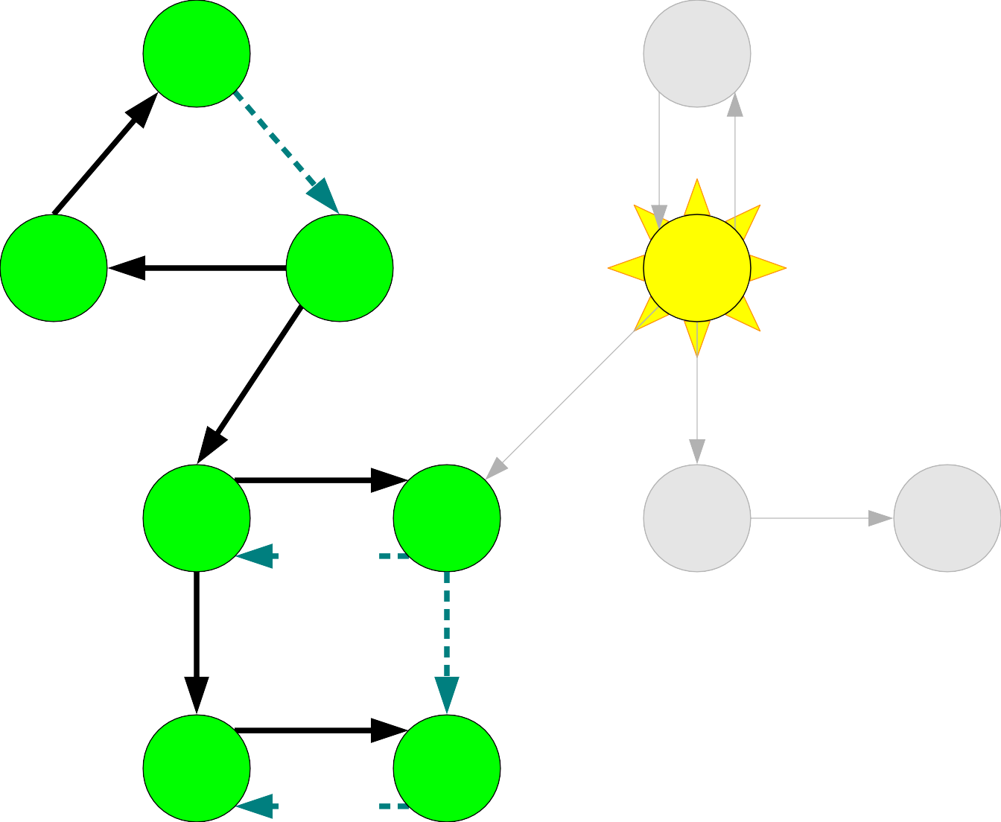
A |  |  | B
C | D |  | E
F |  | G | H I
J |  | K
A
C
K
J
G
F
D

Slide 118
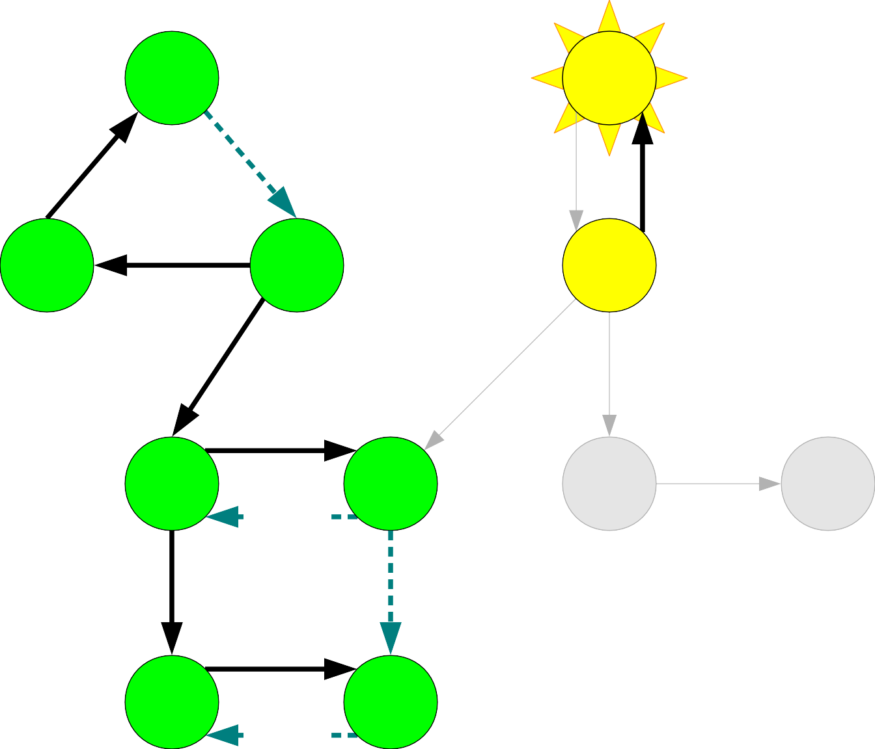
A |  |  | B
C | D |  | E
F |  | G | H I
J |  | K
A
C
K
J
G
F
D

Slide 119

A |  |  | B
C | D |  | E
F |  | G | H I
J |  | K
A
C
K
J
G
F
D

Slide 120
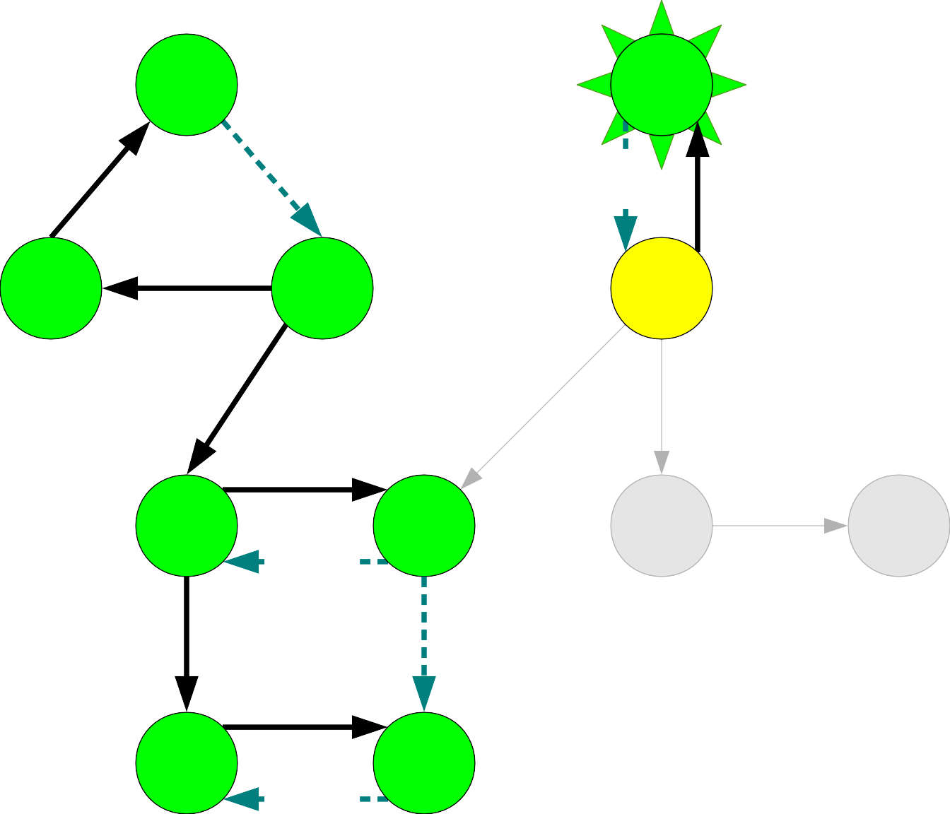
A |  |  | B
C | D |  | E
F |  | G | H I
J |  | K
A
C
K
J
G
F
D

Slide 121

A |  |  | B
C | D |  | E
F |  | G | H I
J |  | K
A
C
K
J
G
F
D
B

Slide 122
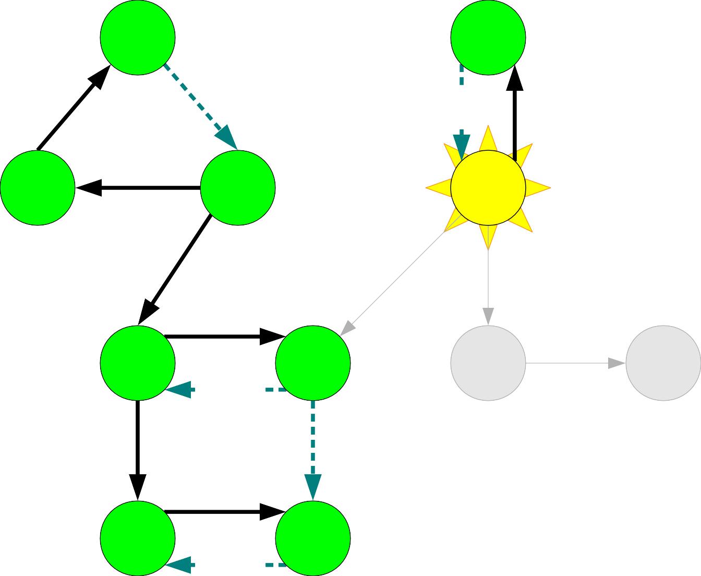
A |  |  | B
C | D |  | E
F |  | G | H I
J |  | K
A
C
K
J
G
F
D
B

Slide 123
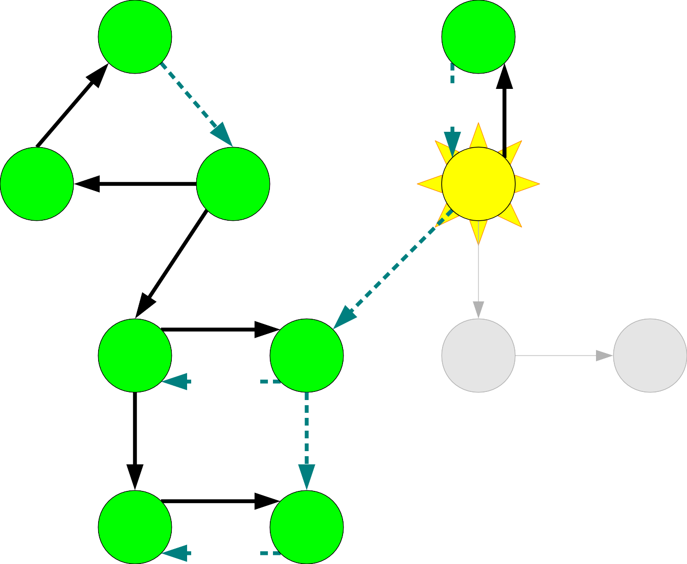
A |  |  | B
C | D |  | E
F |  | G | H I
J |  | K
A
C
K
J
G
F
D
B

Slide 124
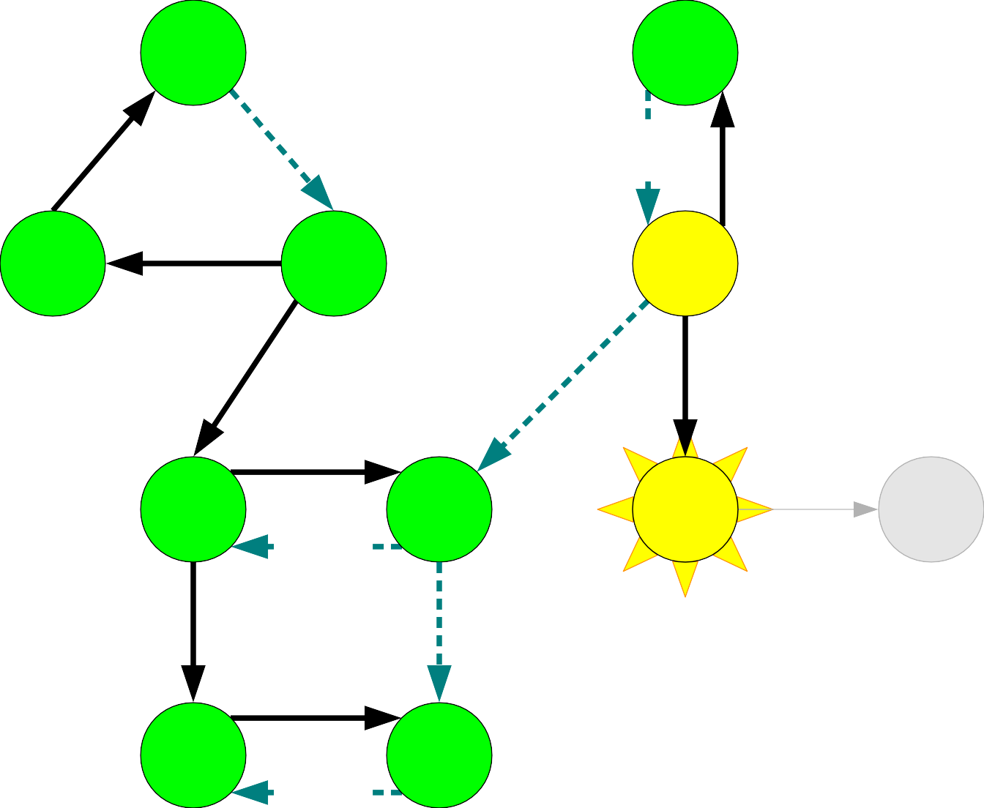
A |  |  | B
C | D |  | E
F |  | G | H I
J |  | K
A
C
K
J
G
F
D
B

Slide 125
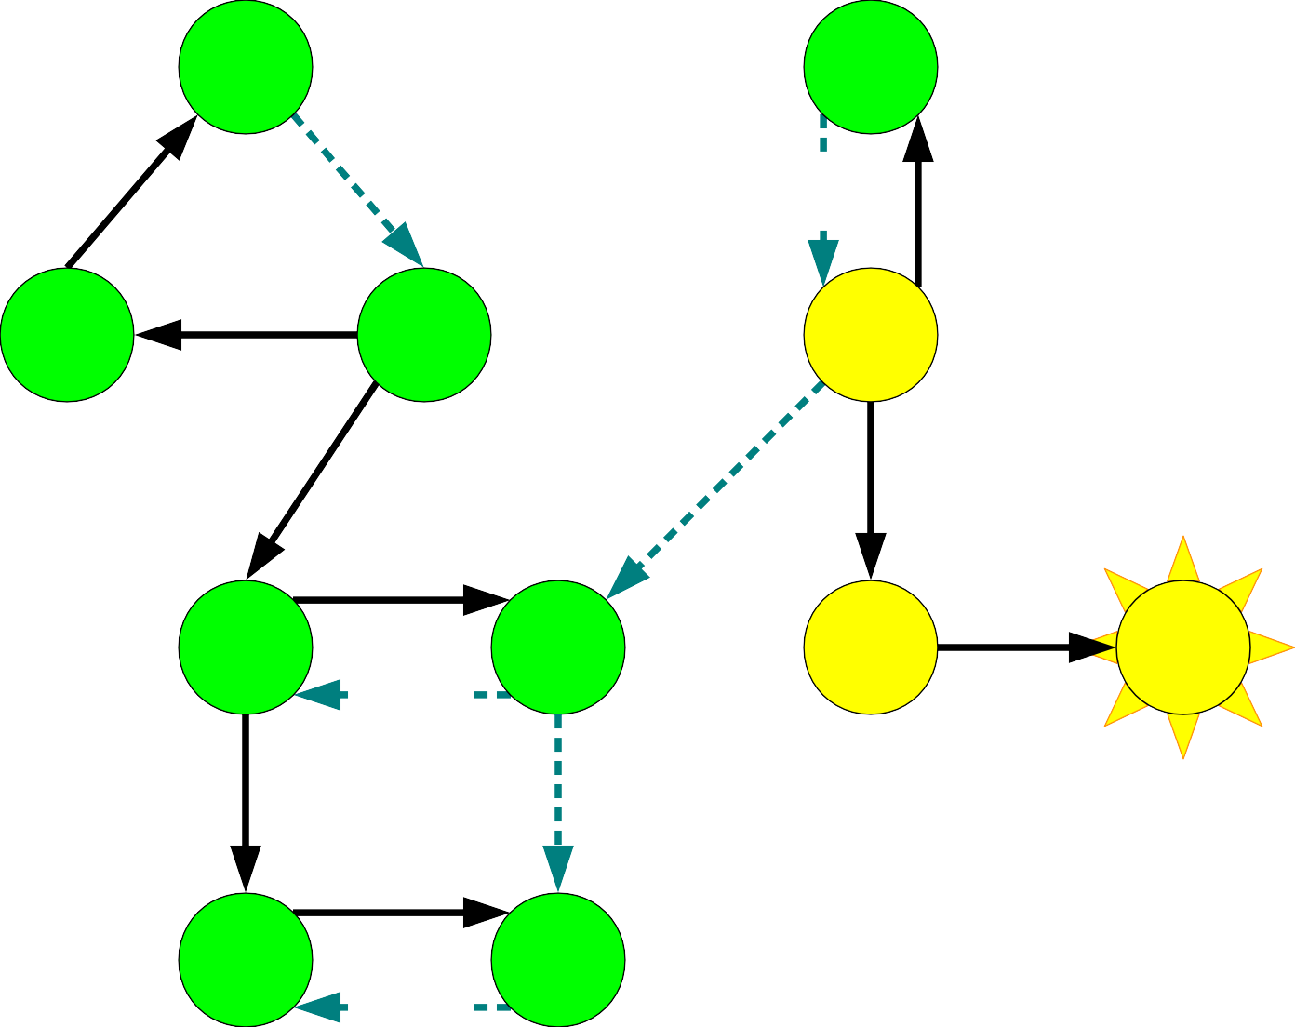
A |  |  | B
C | D |  | E
F |  | G | H I
J |  | K
A
C
K
J
G
F
D
B

Slide 126
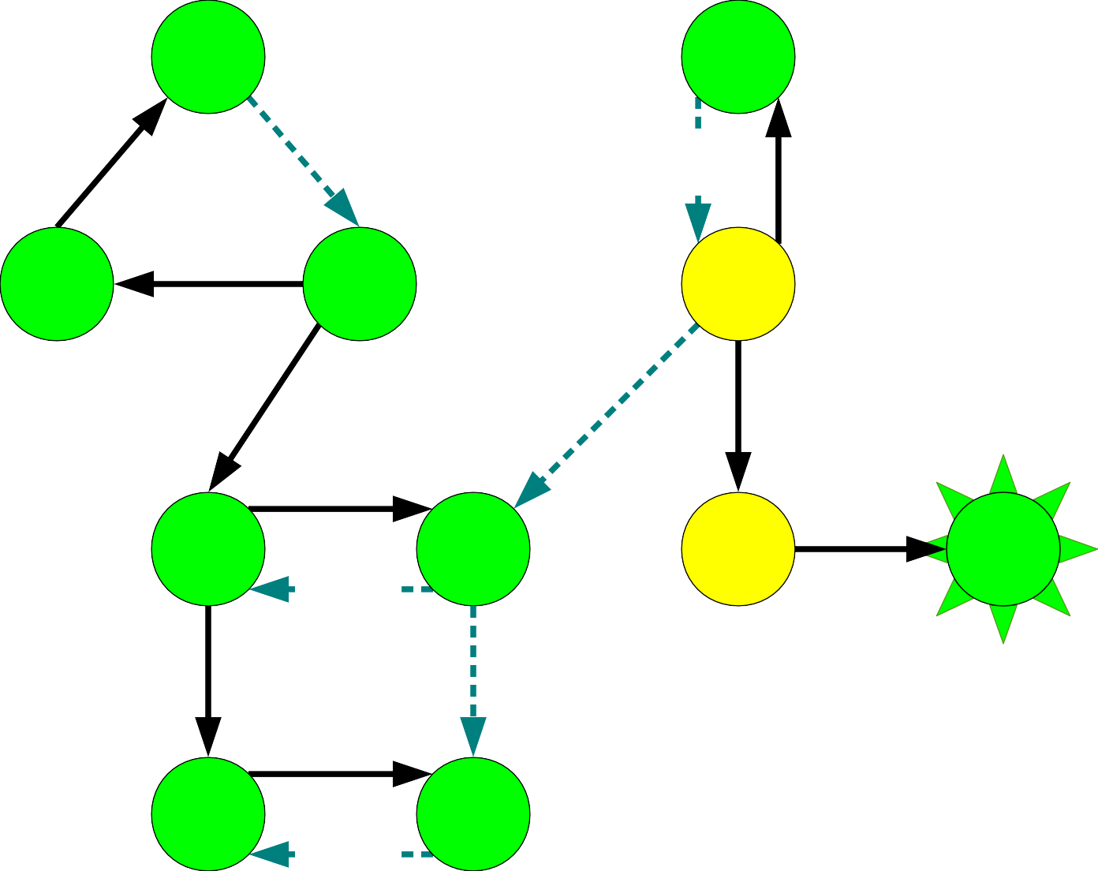
A |  |  | B
C | D |  | E
F |  | G | H I
J |  | K
A
C
K
J
G
F
D
B

Slide 127

A |  |  | B
C | D |  | E
F |  | G | H I
J |  | K
A
C
K
J
G
F
D
B
I

Slide 128
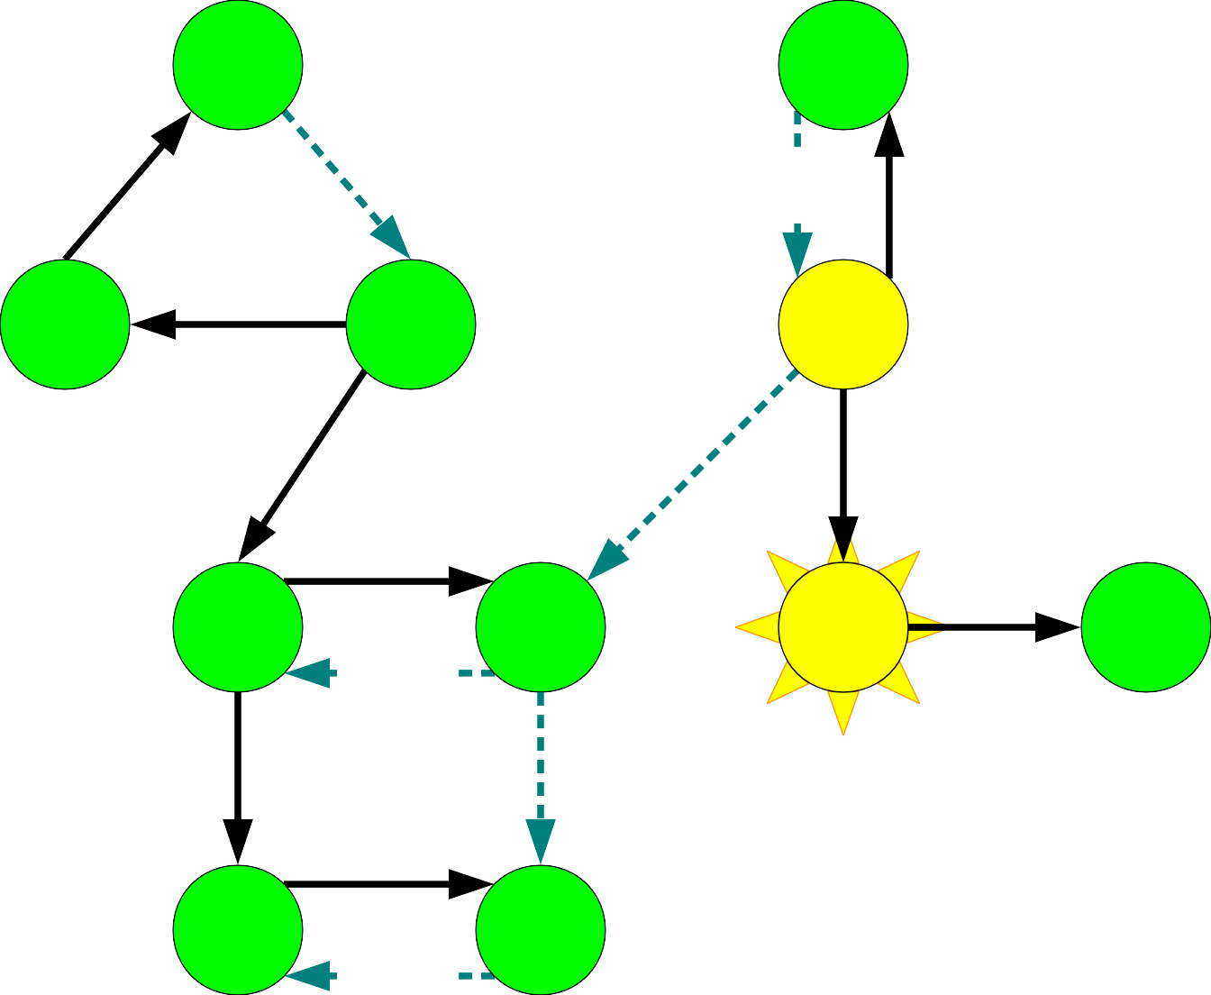
A |  |  | B
C | D |  | E
F |  | G | H I
J |  | K
A
C
K
J
G
F
D
B
I

Slide 129
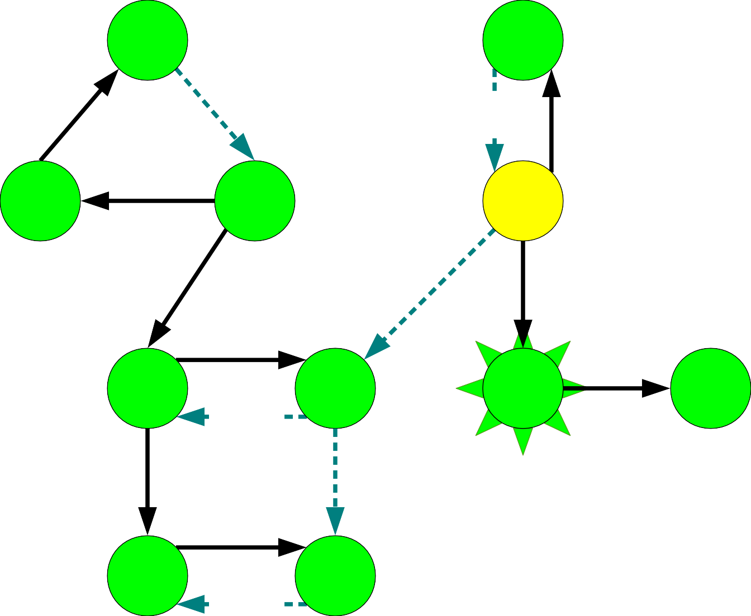
A |  |  | B
C | D |  | E
F |  | G | H I
J |  | K
A
C
K
J
G
F
D
B
I

Slide 130

A |  |  | B
C | D |  | E
F |  | G | H I
J |  | K
A
C
K
J
G
F
D
B
I
H

Slide 131

A |  |  | B
C | D |  | E
F |  | G | H I
J |  | K
A
C
K
J
G
F
D
B
I
H

Slide 132
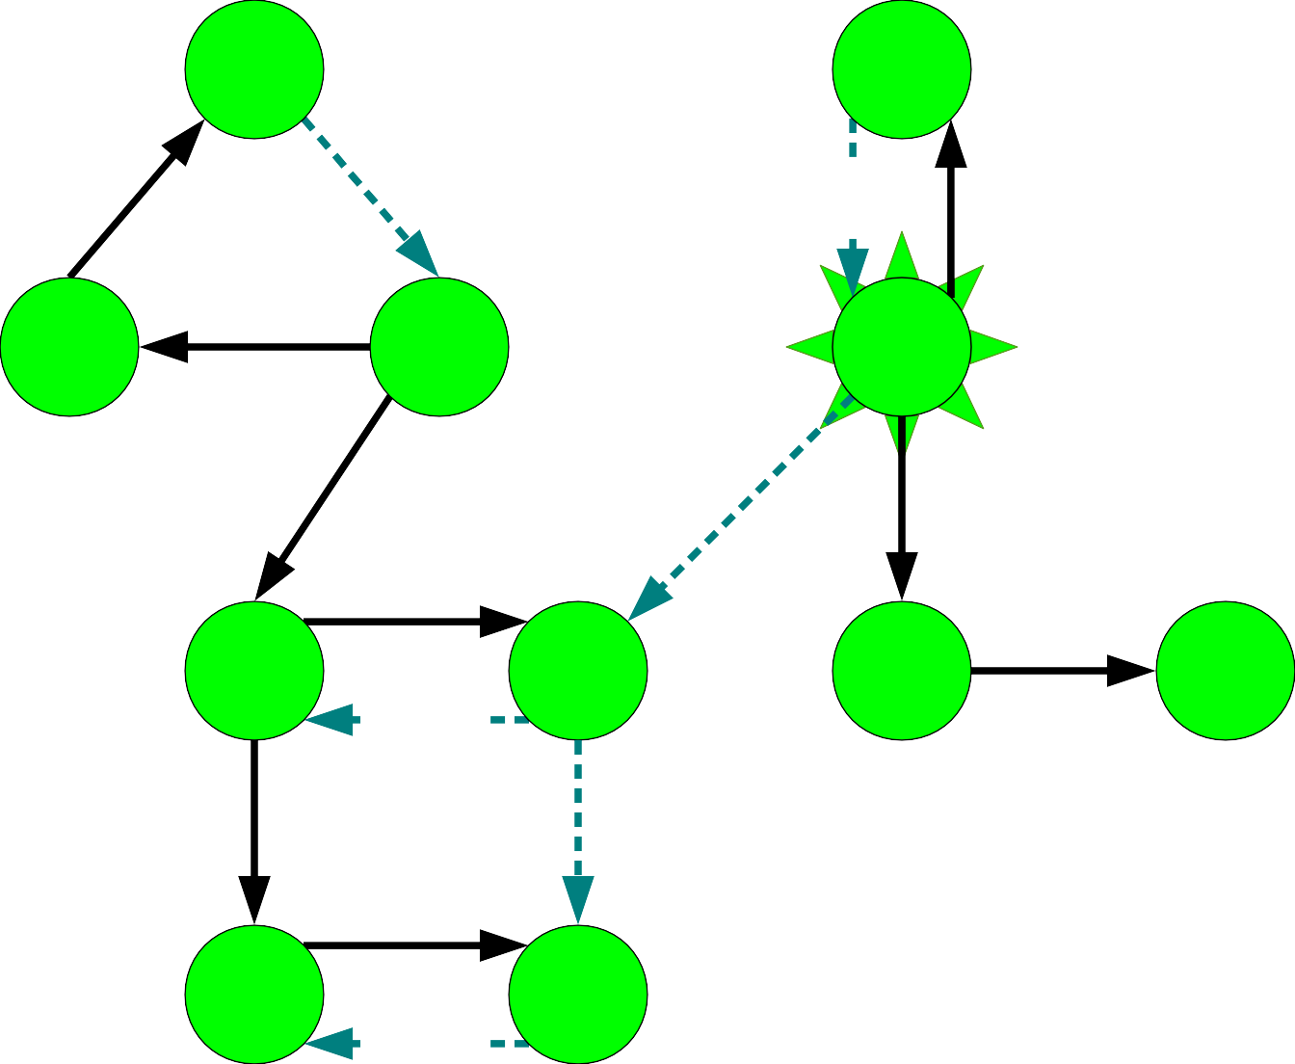
A |  |  | B
C | D |  | E
F |  | G | H I
J |  | K
A
C
K
J
G
F
D
B
I
H

Slide 133
A |  |  | B
C | D |  | E
F |  | G | H I
J |  | K
A
C
K
J
G
F
D
B
I
H
E

Slide 134
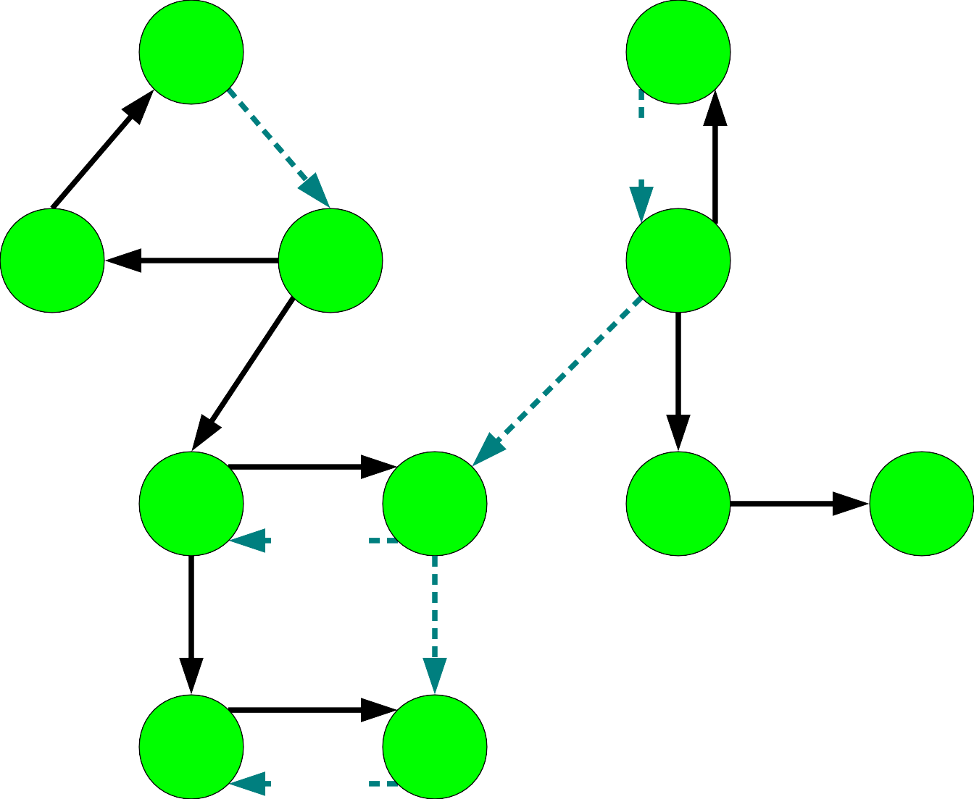
A |  |  | B
C | D |  | E
F |  | G | H I
J |  | K
A
C
K
J
G
F
D
B
I
H
E

Slide 135
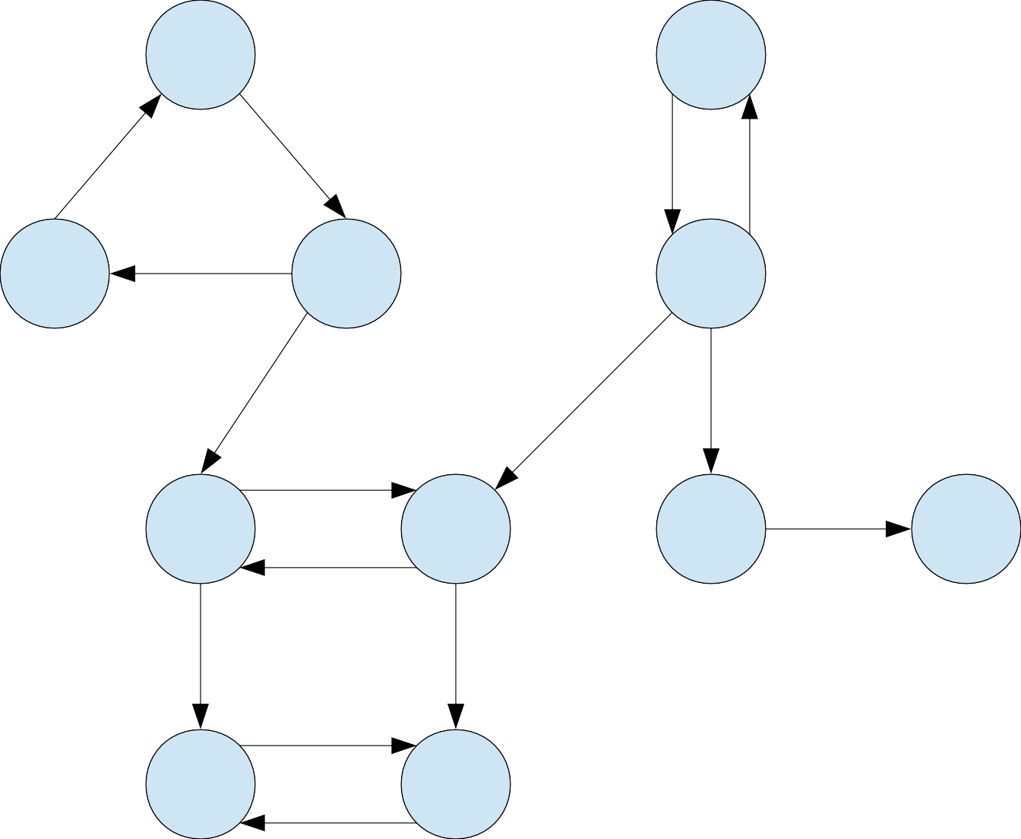
A |  |  | B
C | D |  | E
F |  | G | H I
J |  | K
A
C
K
J
G
F
D
B
I
H
E

Slide 136
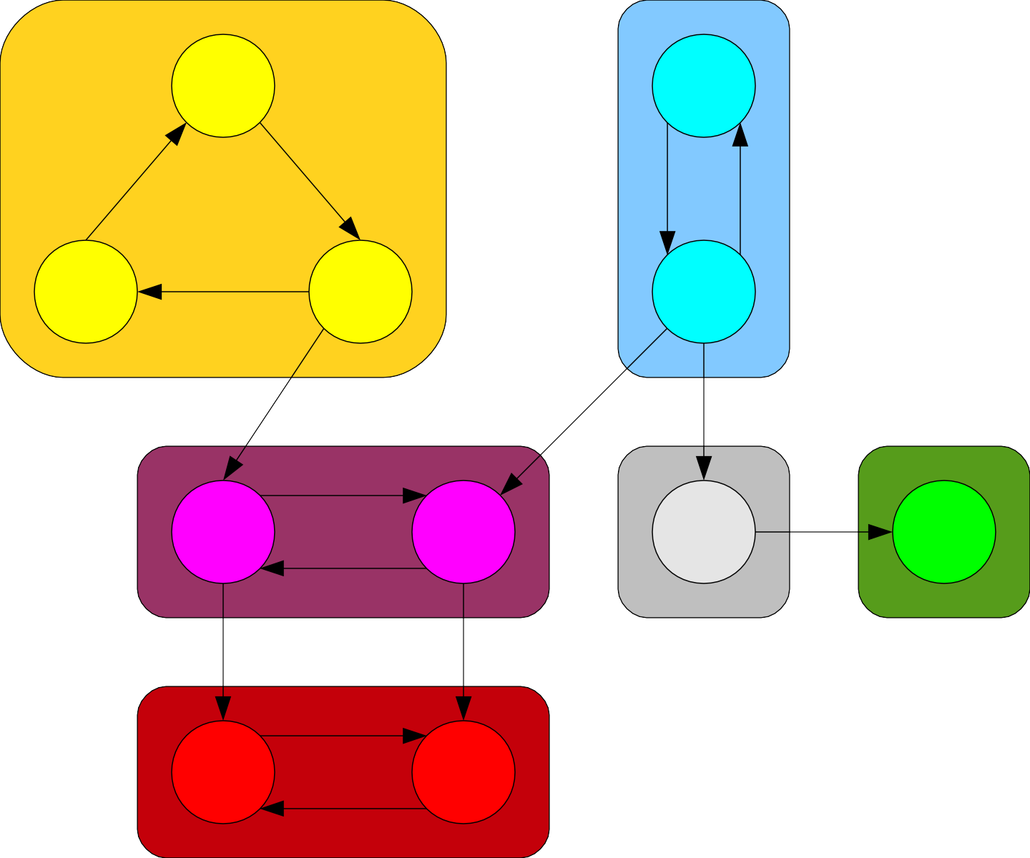
A |  |  | B
C | D |  | E
F |  | G | H I
J |  | K
A
C
K
J
G
F
D
B
I
H
E

Slide 137
A |  |  | B
C | D |  | E
F |  | G | H I
J |  | K
A
C
K
J
G
F
D
B
I
H
E

Slide 138
A |  |  | B
C | D |  | E
F |  | G | H I
J |  | K
A
C
K
J
G
F
D
B
I
H
E

Slide 139
A |  |  | B
C | D |  | E
F |  | G | H I
J |  | K
A
C
K
J
G
F
D
B
I
H
E

Slide 140

A
B
C
D
E
F
G
H
I
J
K
A C K J G F D B I H E E H I D F J

Slide 141
A |  |  | B
C | D |  | E
F |  | G | H I
J |  | K
A
C
K
J
G
F
D
B
I
H
E

Slide 142
A |  |  | B
C | D |  | E
F |  | G | H I
J |  | K
A
C
K
J
G
F
D
B
I
H
E

Slide 143

A |  |  | B
C | D |  | E
F |  | G | H I
J |  | K
A
C
K
J
G
F
D
B
I
H
E

Slide 144

A
C
D
F
G
H
I
J
K
A
C
K
J
G
F
D
B
I
H
E

Slide 145

A
C
D
F
G
H
I
J
K
A
C
K
J
G
F
D
B
I
H
E

Slide 146
A
C F | D | G
J |  | K
I
A
C
K
J
G
F
D
B
I
H
E

Slide 147

A
C F | D | G
J |  | K
I
A
C
K
J
G
F
D
B
I
H
E

Slide 148
A
C F | D | G
J |  | K
A
C
K
J
G
F
D
B
I
H
E

Slide 149

A
C F | D | G
J |  | K
A
C
K
J
G
F
D
B
I
H
E

Slide 150
F G
J K
A
C
K
J
G
F
D
B
I
H
E

Slide 151

F G
J K
A
C
K
J
G
F
D
B
I
H
E

Slide 152
J K
A
C
K
J
G
F
D
B
I
H
E

Slide 153
J K
A
C
K
J
G
F
D
B
I
H
E

Slide 154
A
C
K
J
G
F
D
B
I
H
E

Slide 155
Making Progress!
●
The last node colored green by DFS must be the last node colored green in some SCC.
This gives a rough idea for an algorithm:
●
●
Take the last node in the ordering that hasn't already been put into an SCC.
Find all nodes in the same SCC as that node. Repeat.
●
●

Slide 156
Making Progress!
The last node colored green by DFS must be the last node colored green in some SCC.
This gives a rough idea for an algorithm:
Take the last node in the ordering that hasn't already been put into an SCC.
Find all nodes in the same SCC as that node. Repeat.
●

Slide 157

A |  |  | B
C | D |  | E
F |  | G | H I
J |  | K
A
C
K
J
G
F
D
B
I
H
E

Slide 158
A |  |  | B
C | D |  | E
F |  | G | H I
J |  | K
A
C
K
J
G
F
D
B
I
H
E

Slide 159
A
B
A
C
D
E
C
D
F
G
H I
Claim 1: This node must belong to a source SCC.
J
K
A
C
K
J
G
F
D
B
I
H
E

Slide 160
A |  |  | B
C | D |  | E
F |  | G | H I
J |  | K
A
C
K
J
G
F
D
B
I
H
E

Slide 161
Transpose the Graph

Slide 162

A |  |  | B
C | D |  | E
F |  | G | H I
J |  | K
A
C
K
J
G
F
D
B
I
H
E

Slide 163
A
B
A
C
D
E
C
D
F
G
H I
Claim 2: The SCCs of this reversed graph are the same as the SCCs of the original graph.
J
K
A
C
K
J
G
F
D
B
I
H
E

Slide 164
A
B
A
C
D
E
C
D
F
G
H I
Claim 3: Since E is in a source SCC in the original graph, E is in a sink SCC in this graph.
J
K
A
C
K
J
G
F
D
B
I
H
E

Slide 165
A
B
A
C
D
E
C
D
F
G
H I
Claim 4: The only nodes reachable from E are the nodes in the same SCC as E.
J
K
A
C
K
J
G
F
D
B
I
H
E

Slide 166
A |  |  | B
C | D |  | E
F |  | G | H I
J |  | K
A
C
K
J
G
F
D
B
I
H
E

Slide 167

A |  |  | B
C | D |  | E
F |  | G | H I
J |  | K
A
C
K
J
G
F
D
B
I
H
E

Slide 168

A |  |  | B
C | D |  | E
F |  | G | H I
J |  | K
A
C
K
J
G
F
D
B
I
H
E

Slide 169
A |  |  | B
C | D |  | E
F |  | G | H I
J |  | K
A
C
K
J
G
F
D
B
I
H
E

Slide 170
A
B
C
D
E
F
G
H I
Claim 5: The only unvisited nodes reachable from H are the nodes in the same SCC as H.
J
K
A
C
K
J
G
F
D
B
I
H
E

Slide 171


A |  |  | B
C | D |  | E
F |  | G | H I
J |  | K
A
C
K
J
G
F
D
B
I
H
E

Slide 172

A |  |  | B
C | D |  | E
F |  | G | H I
J |  | K
A
C
K
J
G
F
D
B
I
H
E

Slide 173


A |  |  | B
C | D |  | E
F |  | G | H I
J |  | K
A
C
K
J
G
F
D
B
I
H
E

Slide 174

A |  |  | B
C | D |  | E
F |  | G | H I
J |  | K
A
C
K
J
G
F
D
B
I
H
E

Slide 175

A |  |  | B
C | D |  | E
F |  | G | H I
J |  | K
A
C
K
J
G
F
D
B
I
H
E

Slide 176


A |  |  | B
C | D |  | E
F |  | G | H I
J |  | K
A
C
K
J
G
F
D
B
I
H
E

Slide 177

A |  |  | B
C | D |  | E
F |  | G | H I
J |  | K
A
C
K
J
G
F
D
B
I
H
E

Slide 178


A |  |  | B
C | D |  | E
F |  | G | H I
J |  | K
A
C
K
J
G
F
D
B
I
H
E

Slide 179

A |  |  | B
C | D |  | E
F |  | G | H I
J |  | K
A
C
K
J
G
F
D
B
I
H
E

Slide 180

A |  |  | B
C | D |  | E
F |  | G | H I
J |  | K
A
C
K
J
G
F
D
B
I
H
E

Slide 181


A |  |  | B
C | D |  | E
F |  | G | H I
J |  | K
A
C
K
J
G
F
D
B
I
H
E

Slide 182

A |  |  | B
C | D |  | E
F |  | G | H I
J |  | K
A
C
K
J
G
F
D
B
I
H
E

Slide 183

A |  |  | B
C | D |  | E
F |  | G | H I
J |  | K
A
C
K
J
G
F
D
B
I
H
E

Slide 184

A |  |  | B
C | D |  | E
F |  | G | H I
J |  | K
A
C
K
J
G
F
D
B
I
H
E

Slide 185
A |  |  | B
C | D |  | E
F |  | G | H I
J |  | K
A
C
K
J
G
F
D
B
I
H
E

Slide 186
procedure kosarajuSCC(graph G):
for each node v in G: color v gray.
let L be an empty list.
for each node v in G: if v is gray:
run DFS starting at v, appending each node to list L when it is colored green.
construct G^{R} from G.
For each node v in G^{R}: color v gray.
let scc be a new array of length n
let index = 0
for each node v in L, in reverse order:
if v is gray:
run DFS on v in G^{R}, setting scc[u] = index for each node u colored green this way.
index = index + 1
return scc

Slide 187
Proving Correctness
Here's a quick sketch of the correctness proof of Kosaraju's algorithm:
As proven earlier, the last nodes in each SCC will be returned in reverse topological order.
Each time we do a DFS in the reverse graph starting from some node, we only reach nodes in the same SCC or in ancestor SCCs.
Since we process the SCCs in topological order, at each point the only unvisited nodes reachable are nodes in the same SCC.

Slide 188
Kosaraju's Algorithm Runtime
What is the runtime of the Kosaraju's algorithm?
Runtime for running DFS starting from each node in the graph: Θ(m + n).
Runtime for reversing the graph and coloring all nodes gray: Θ(m + n).
Runtime for running DFS in the reversed graph: Θ(m + n).
Total runtime: Θ(m + n).
This is a linear-time algorithm!

Slide 189
Why all this matters
Depth-first search is an important building block for many other algorithms, including topological sorting, finding connected components, and Kosaraju's algorithm.
We can find CCs and SCCs in (asymptotically) the same amount of time.
Further reading: look up Tarjan's SCC algorithm for a way to find SCCs with a single DFS!

Slide 190
SCCs and DAGs

Slide 191
Condensation Graphs
The condensation of a directed graph G is the directed graph G^{SCC} whose nodes are the SCCs of G and whose edges are defined as follows:
(C₁, C₂) is an edge in G^{SCC} iff ∃u ∈ C₁, v ∈ C₂. (u, v) is an edge in G.
In other words, if there is an edge in G from any node in C₁ to any node in C₂, there is an edge in G^{SCC} from C₁ to C₂.

Slide 192


Slide 197


Slide 198


Slide 205
An Amazing Result
●
Theorem: For any directed graph G, the condensation G^{SCC} of G is a DAG.
Proof Sketch:
●
Notes:
Therefore, u and v′ are reachable from each other, so they are not in separate SCC’s

Slide 206
Conclusion
Theorem: For any directed graph G, the condensation G^{SCC} of G is a DAG.
Proof Sketch:

Slide 207
An Amazing Result
Theorem: For any directed graph G, the condensation G^{SCC} of G is a DAG.
Proof Sketch:

Slide 208
SCCs and DAGs
We now see that there is a close connection between SCCs and DAGs: the SCCs of a graph form a DAG.
Intuitively, you can think of a graph as a two-layer structure:
At a high level, a graph is a DAG of SCCs showing the top-level connections between clusters of nodes.
At a lower level, you can see the connections between nodes in the same SCC.

Slide 209
SCCs and DAGs
Now that we have found a connection between SCCs and DAGs, can we adapt any of our algorithms on DAGs to find SCCs?
Right now, our main operation on DAGs is topological sort, and we have two algorithms we can use:
Repeatedly removing a source node. That won't help us here, since we can't easily tell if a node is in a source SCC.
Running DFS and reversing the result. So what happens if we try that out?

